Slide 1


LGM Grand Rounds August 17, 2023
FACULTY: To receive CME credit please scan this QR Code and use your WUSTL Key to sign in
Credit Available For This Activity
In support of improving patient care, Washington University School of Medicine in St. Louis is jointly accredited by the Accreditation Council for Continuing Medical Education (ACCME), the Accreditation Council for Pharmacy Education (ACPE), and the American Nurses Credentialing Center (ANCC) to provide continuing education for the healthcare team.
American Medical Association (AMA) Washington University School of Medicine in St. Louis designates this live activity for a maximum of 1 AMA PRA Category 1 CreditsTM.
All disclosures are valid for one year from the Last Confirmed date. If older than one year from the date of the talk, the disclosure must be updated.
Any relationship shown below in italics has been divested within the last 24 months and is therefore considered mitigated. All relevant financial relationships have been mitigated.
Disclosures: None
Course Chair: Neil Anderson, MD: Speakers Bureau/Honoraria: Alere, Biomerieux; Consulting/Advisory Committee: Diasorin Molecular
Planning Committee: Rachel Bosserman, PhD: Nothing to disclose
Session Speaker: Christopher Snyder, MD, PhD
To receive CME credit, please scan this QR Code using your WUSLT Key to login:

Slide 2
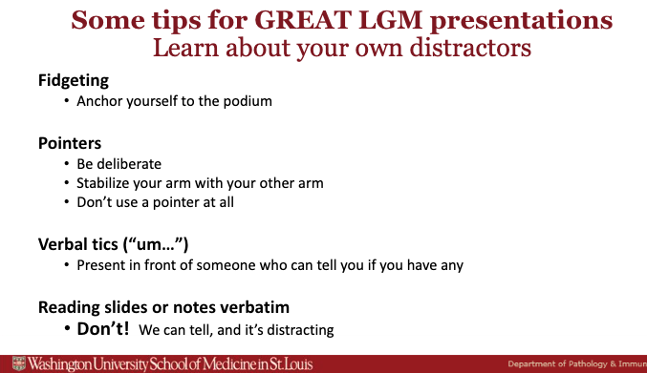
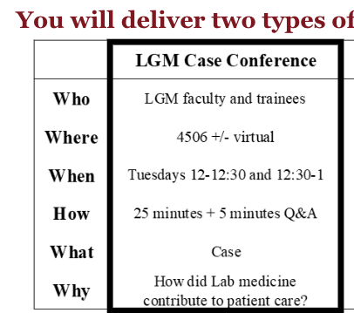
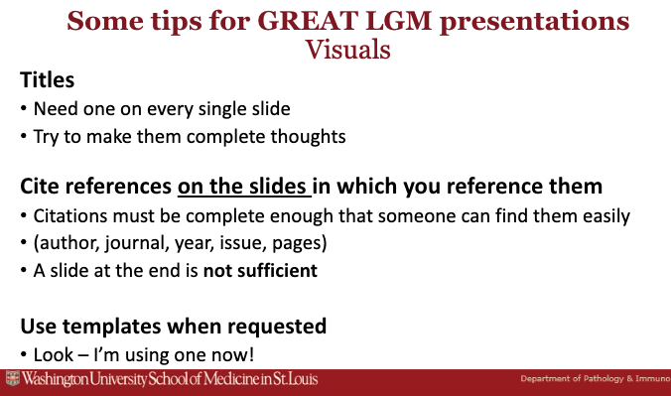
On Preclinical Variation and TSH Interpretation
Christopher Snyder, MD, PhD
Division of Laboratory and Genomic Medicine
Department of Pathology & Immunology
August 17, 2023
Notes:
recent patient case:
accession # 22-194-4341 MRN: 201139746

Slide 3
Disclosures
I have no relevant or financial disclosures.

Slide 4
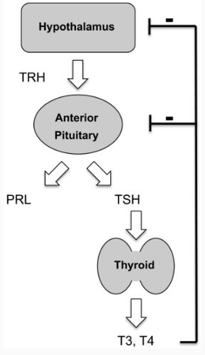
Learning Objectives
By the end of this session, the learner should be able to:
Describe the biology, measurement, and interpretation of TSH.
Evaluate literature on sources of healthy TSH variation.
Study reference interval constructions and limitations.
Cover feasibility of a “big data” approach.

Slide 5


Slide 6
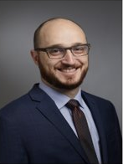
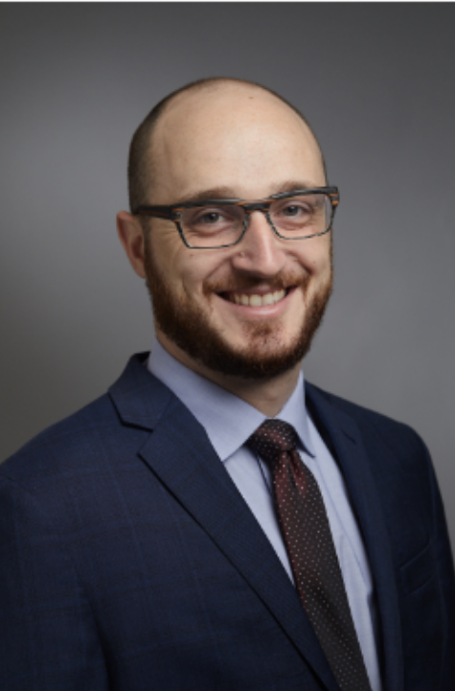
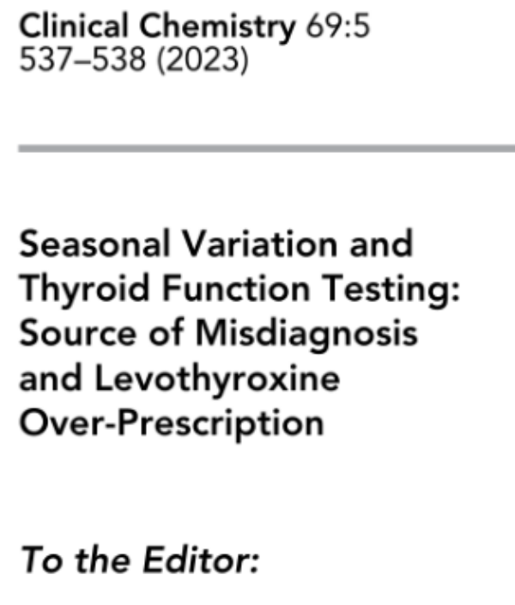
Dr. El-Khoury
"Seasonal Variation may lead to...
false diagnosis of subclinical hypothyroidism
and unnecessary prescriptions."
"War on Error" Talk
Clin Chem Letter
Seasonal TSH
“Seasonal Variation in Thyroid Function”, Yamada et al.

Slide 7
Dr. El-Khoury
"Seasonal Variation may lead to...
false diagnosis of subclinical hypothyroidism
and unnecessary prescriptions."
Therapeutic intervals
Outcome-based cutoffs
Better answers the question for which a physician orders the labs
Answers the question, "Should I treat?"
"War on Error" Talk
Clin Chem Letter
Seasonal TSH
“Seasonal Variation in Thyroid Function”, Yamada et al.

Slide 8
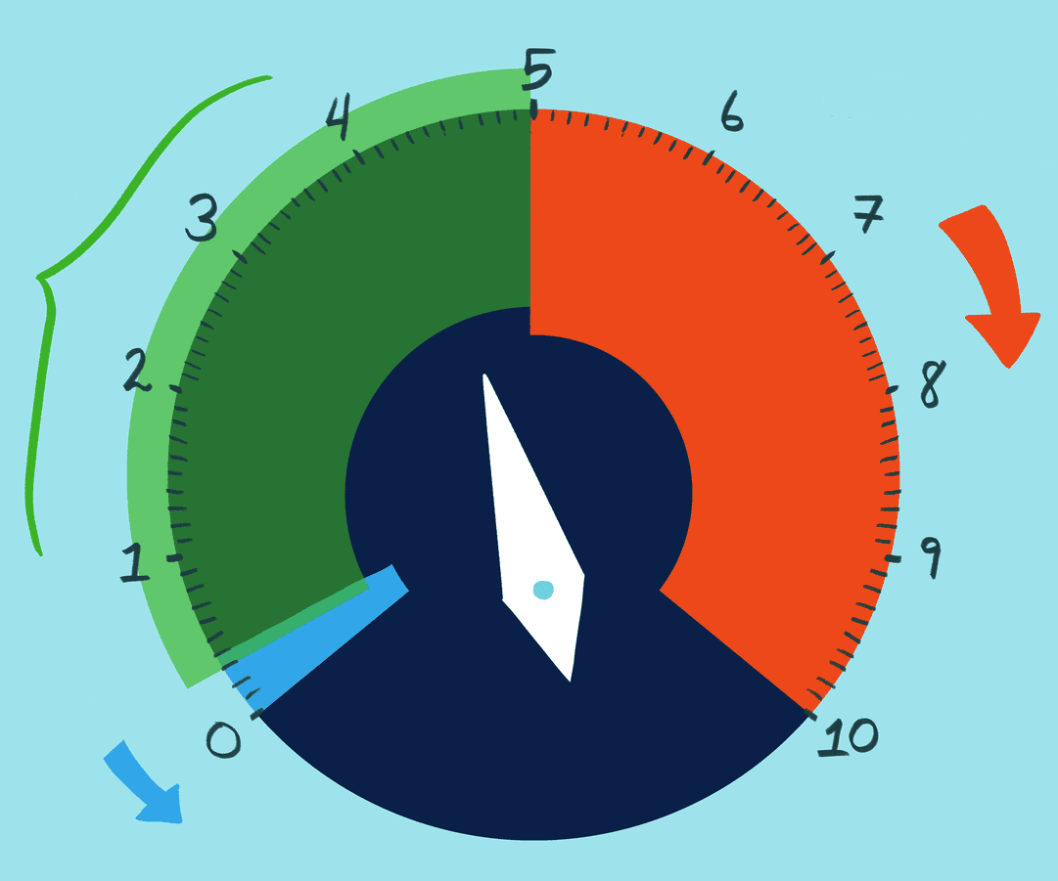
Subclinical Hypothyroidism (briefly)
Defined by
1. Slightly elevated TSH concentration
2. Normal T4
Treated with
T4 replacement
Cartoon of TSH. Normal Range (Green)

Slide 9
The Decision Limits for Treatment
Agreement on Extremes
Clear guidance only for TSH > 10 ^{mIU/L, 1}
No treatment within "normal" (0.3 – 4.2 ^{mIU/L})
Controversy in Between
"No benefit" of treatment unless TSH exceeds 7 – 10 ^{mIU/L, 2}
Controversial recommendation to lower the upper limit to 2.5 ^{mIU/L, 3}
Reference range adjusts over time with assay sensitivity
¹ AACE and ATA Guidelines; 2012
² Ross, "Treating Hypothyroidism Is Not Always Easy".
³ NACB Laboratory Medicine Practice Guidelines (LMPG) - Laboratory Support of the Diagnosis and Monitoring of Thyroid Disease: PDF Documents, NACB, 2002.

Slide 10
Are We Overtreating?
30% increase in Synthroid prescriptions over the past decade. ⁴
TSH level for initiation steadily decreasing: "between TSH values of 5 − 9^{mIU/L} for 61% of new Synthroid prescriptions.⁵"
“the vast majority of patients initiated on Synthroid had only mild TSH elevations. . . and resulted in no improvement in health-related quality of life over time” ⁴
⁴Rodriguez-Gutierrez et al., “Levothyroxine Overuse”, (OptimLabs, systematic review).​
⁵Ross, “Treating Hypothyroidism Is Not Always Easy”.​

Slide 11
How Big is the Impact?
Volume
Treatment – Synthroid is one of the Top 3 prescriptions in the USA.
5%-10% disease prevalence by USA epidemiology studies.
Testing – $60,000 annually at BJC.
Gravity
Wrong choices increase mortality.
Pan–organ morbidity.
Responsibility​
Clinician relies on Pathologist for establishing significance.

Slide 12
No Safe Hedge
Undertreatment
Increased Mortality
Cardiovascular epidemiological studies of untreated subclinical hypothyroidism demonstrate increased cardiovascular mortality.
Hazard Ratio (HR) in untreated SCHO for coronary heart disease mortality was 1.42ª.
Overtreatment
Increased Mortality
Demonstrated Risk of Atrial Fibrillation and Stroke, per every std dec TSH.
Adverse skeletal (osteoporosis) and psychological effects.
ª Ross, Treating Hypothyroidism is Not Always Easy. Journal of Internal Medicine. 2021.​
Notes:
Evron JM et al 2022 Association of thyroid hormone treatment intensity with cardiovascular mortality among US veterans. JAMA Netw Open 5(5):e2211863. PMID: 35552725.
Risk of death was correlated with both a decreased and an increased TSH levels. Risk of death was increased by 39% if the TSH was suppressed and 13% if the TSH was low but detectable. Risk of death increased steadily as the TSH increased above the normal range, from 42% for a slightly increased TSH to 267% if the TSH was >20. The risk was even higher in older patients (>85) when compared with younger patients, ranging age to 18 to 49 years.

Slide 13
A Good Idea Addressing a Related Need
Someone should do that...
Clinical decision support for physicians
Perhaps with a therapeutic interval, doctors would not overload the reference interval for therapeutic decisions.
However​,
Those treatment data do not exist​
Does not address diagnosis​
It makes assumptions about the therapy in question​
​
Moreover, “Which” Therapeutic Interval?​
Need additional intervals for each therapeutic?​
For each treatment–goal?

Slide 14
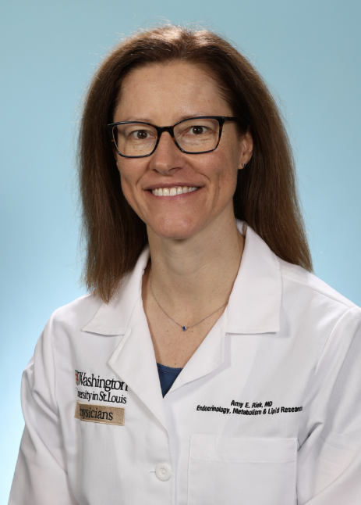


An Endocrinologist's Perspective
Dr. Reik:
Thinks at BJH that most use high threshold for treatment
This would avoid the risk of seasonal over-prescription
*our climate has not been studied
*there are risks of under-prescription
She also mentioned:
The more egregious misapplication of the reference interval is to assess thyroid function in a sick inpatient
*NACB, 2003: context dependent reference intervals: twice the upper cut-off for inpatients

Slide 15
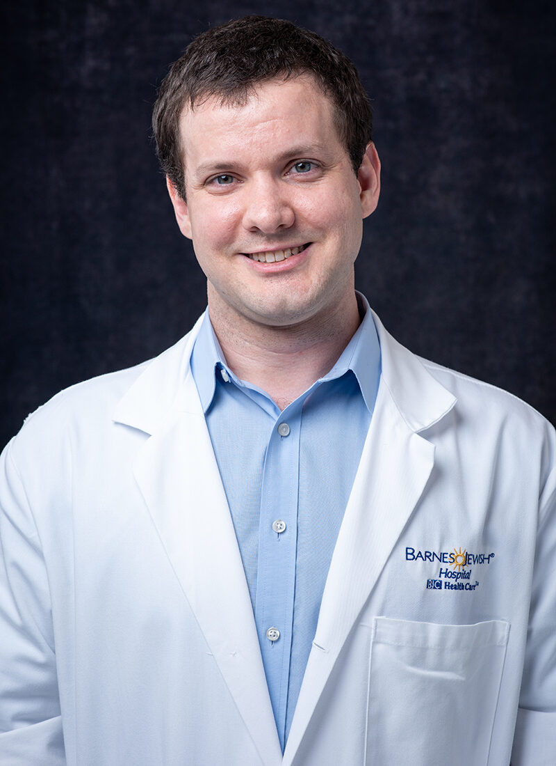
Proposal:
Seasonal intervals that …
model “context-dependent significance”
correctly predict lab values 95% of the time
are called “Null Intervals”
do not replace reference intervals
Notes:
“Interpretation is context dependent…”

Slide 16
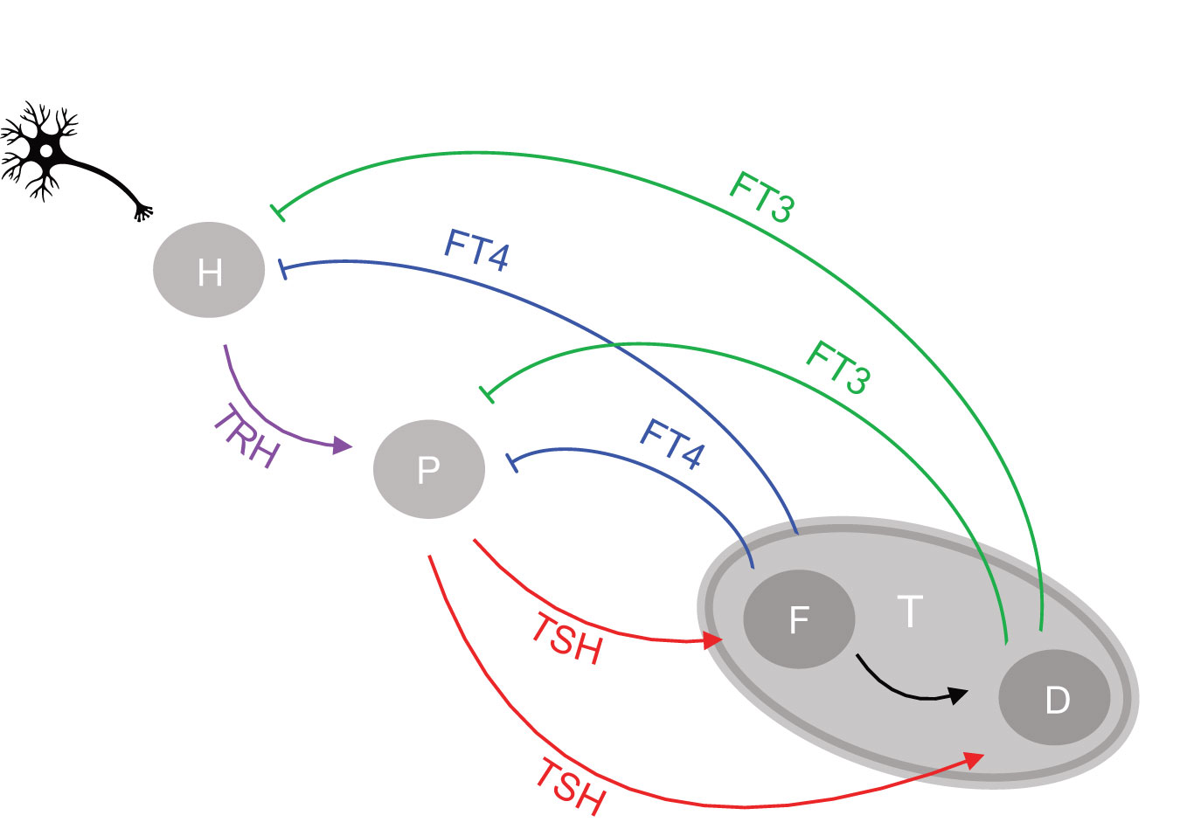
TSH Biology
H
Afferent signals project to the H from higher brain centers.
Communicate through an interactive network of positive feedforward (arrows) and negative feedback loops (bars).
Involving as signals the respective hormones produced and released by each gland into the circulation,
namely TRH by the ,
TSH by the ,
T4 and T3 by the .
H
P
T
Hoermann, R. Principles of Endocrine Regulation (2022).
Notes:
But before I can continue that journey, let’s all get to the same page.
…Melaton dependent release of thyroid-stimulating hormone (TSH) in the pars tuberalis of the pituitary gland
Low temperatures stimulate the production of thyroliberin by neurosecretory cells of the hypothalamus,
TSH Error Signal, "logarithmic" suitable for measurement
Sensitivity to Situation
Controllable at Evaluation
Time of Day, Satiety, Sickness, 15-20 Pharm
Uncontrollable at Evaluation
Seasonality, Age, Time of Year, Pregnancy

Slide 17
TSH Biology
F
T3 is both synthesized de novo in the thyroid follicular cell (F)
and converted from T4 as a precursor by deiodinases (D).
The circulating free forms of T4 and T3 are referred to as
FT4 and FT3, respectively.
D
(2022) Rudolf Hoermann. Principles of Endocrine Regulation
Notes:
Network of the hypothalamic-pituitary-thyroid axis regulation. Afferent signals project to the hypothalamus from higher brain centers. The hypothalamus (H), pituitary (P), and thyroid gland (T) communicate through an interactive network of positive feedforward (arrows) and negative feedback loops (bars), involving as signals the respective hormones produced and released by each gland into the circulation, namely TRH by the hypothalamus, TSH by the pituitary and T4 and T3 by the thyroid gland. T3 is both synthesized de novo in the thyroid follicular cell (F) and converted from T4 as a precursor by deiodinases (D). The circulating free forms of T4 and T3 are referred to as FT4 and FT3, respectively.
Stability to Perturbation
System Critical --> Tight Regulation
TSH Error Signal, "logarithmic" suitable for measurement
Sensitivity to Situation
Controllable at Evaluation
Time of Day, Satiety, Sickness, 15-20 Pharm
Uncontrollable at Evaluation
Seasonality, Age, Time of Year, Pregnancy

Slide 18
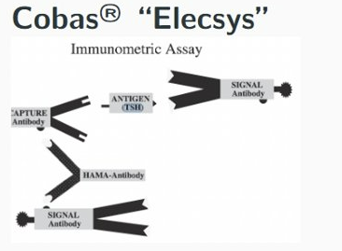
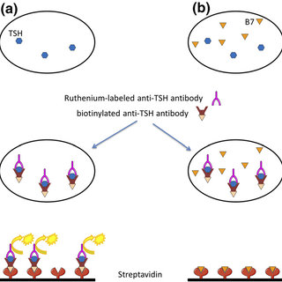
TSH Measurement
Sandwich Assay
1. TSH‑specific monoclonal antibody (mAB)
Biotinylated
Ruthenium Labeled
2. Magnetic Capture
Streptavidin-coated microparticles
3. Voltage induced chemiluminescent
Antibodies labeled with ruthenium
Caveats?
No HAMA (chimeric AB)
No hook
No HIL
Yes: macro-TSH due to auto-AB
(unexpectedly high result)
Notes:
Over the years the assay for TSH has become the most sensitive measure of the wellbeing of the thyroid axis.
electrochemiluminescence immunoassay
We use an immunoassay invovling a monoclonal antibody in a two step biotin capture system. Quantification is achieved through chemiluminescence and comparison with a standard curve of luminescence for known TSH values
You may be wondering if these values can sometimes be misleading. Fortunately there are few analytic caveats.
However, post-analytic interpretation depends on comparison with a reference interval.

Slide 19
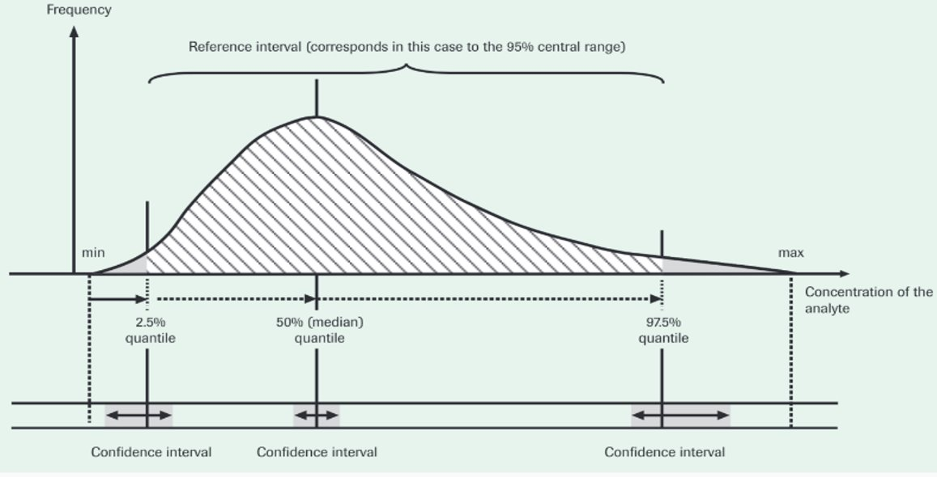
The Reference Range
Reference Population ("Healthy Controls)
Random sample from population of healthy individuals
Reference Range (Reference Interval)
Quantiles estimated from samples
Notes:
First we will start with the definition
Quantile is used interchangably with percentile

Slide 20
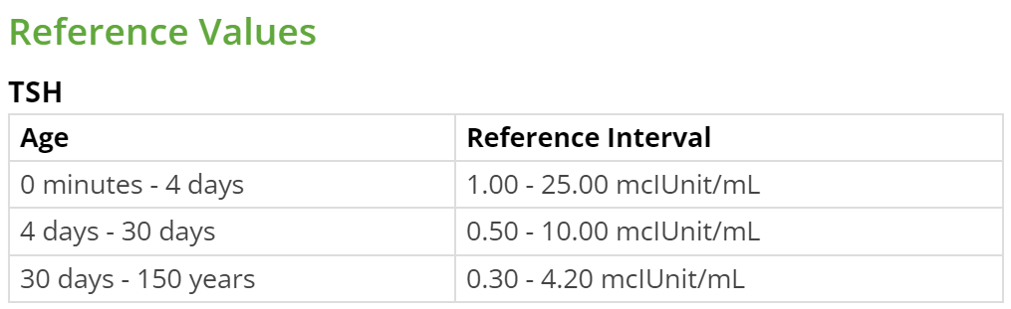
Establishing Reference Intervals
Use healthy volunteers for "normal" (direct method).
CLSI: Specific Guidelines
120 person recommendation
2.5%, 97.5% Percentiles estimated
Many choose to verify manufacturer interval
“non-parametrically” (usually empirically)
TSH: Reference Values (BJH Catalog)
Notes:
Now that we have established common terminology, I will resume the story.

Slide 21
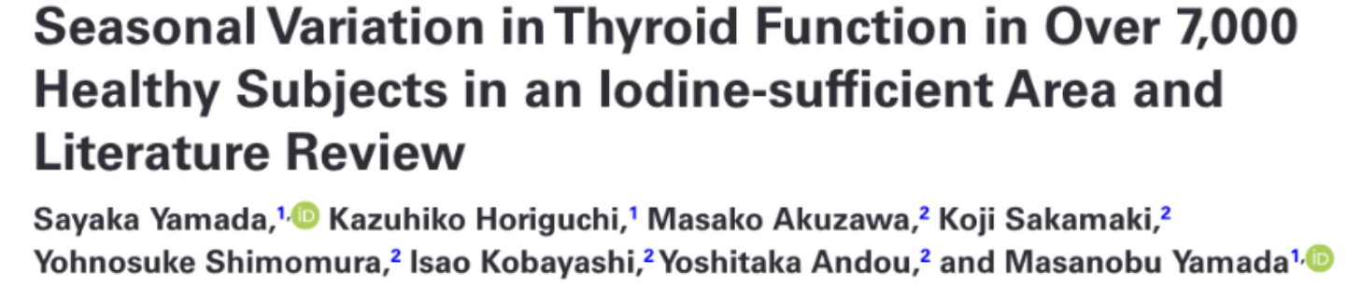
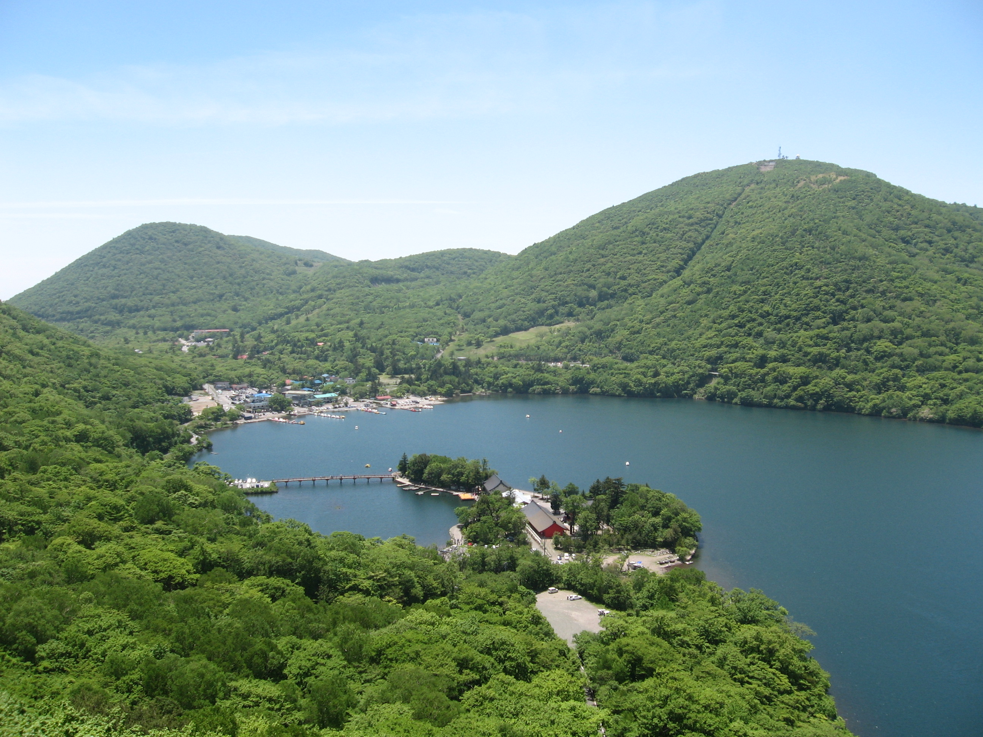
Dr. El-Khoury referenced paper on TSH Seasonality
Background
Existing literature suggests seasonality but is conflicting
Previous studies lacked stringent, healthy controls
Study Design
Cross–sectional, annual check-up
Gunma Prefecture, Japan
12 month period
Yamada, S. et al. J Endocr Soc. 2022 PMID: 35528829

Slide 22
Study Design
Exclusion Criteria (Questionnaire)
Overt or historical thyroid disease
Liver cirrhosis
Renal failure
Relevant medications, illness, steroid hormones
Methodology
Collect TSH, FT3, FT4
Blood samples collected 8:00 to 9:00 am (to exclude diurnal variation)
All subjects had fasted 11 hours
Population
6,343 (3,667 men) age 53.8 ± 11 years
Notes:
The diurnal variation and fasting interested me as I did not know about their effects on TSH.
Peak daily TSH is at least twice the trough
Fortunately we don’t have to worry about this because we can standardize when samples are collected

Slide 23
Yamada et al, Data
Month | Positive by RI n(%)
January | 17 (2.71)
February | 17 (2.61)
March | 12 (2.17)
April | 5 (1.31)
May | 3 (1.21)
June | 4 (1.08)
July | 7 (1.55)
August | 6 (1.02)
September | 3 (0.54)
October | 4 (0.66)
November | 7 (1.22)
December | 5 (0.68)
All | 90 (1.42)
Yamada et all. 2022. Figure 1. Replotted.
Table 2. Replotted.

Slide 24
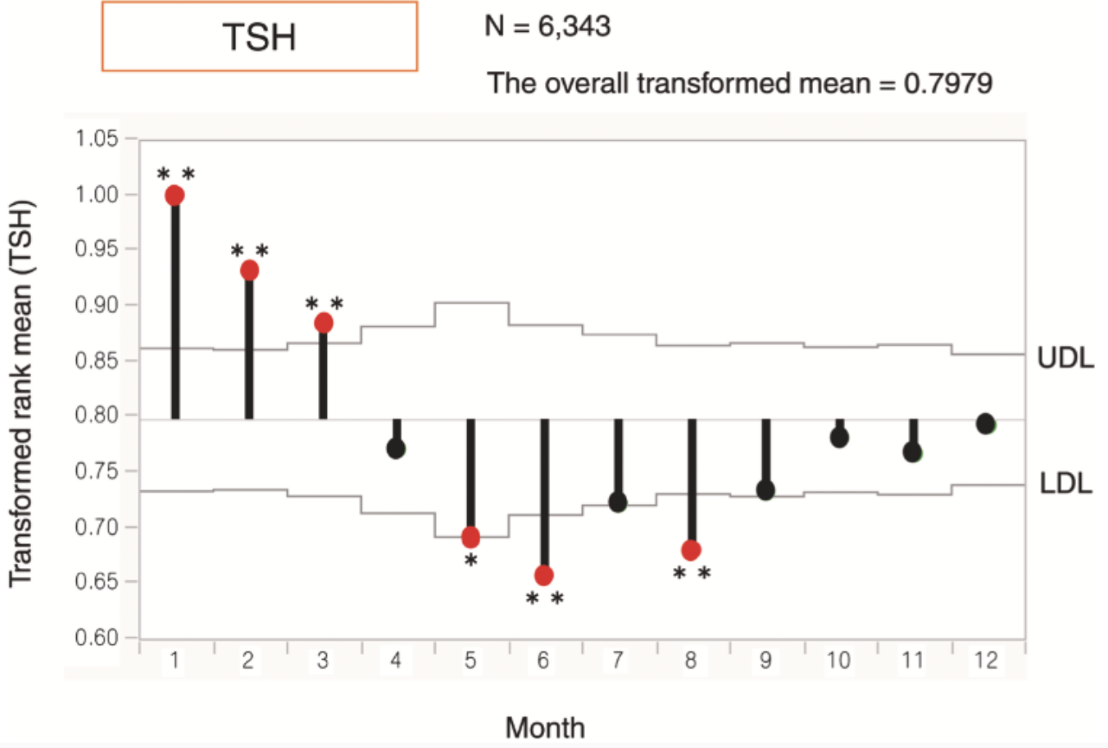
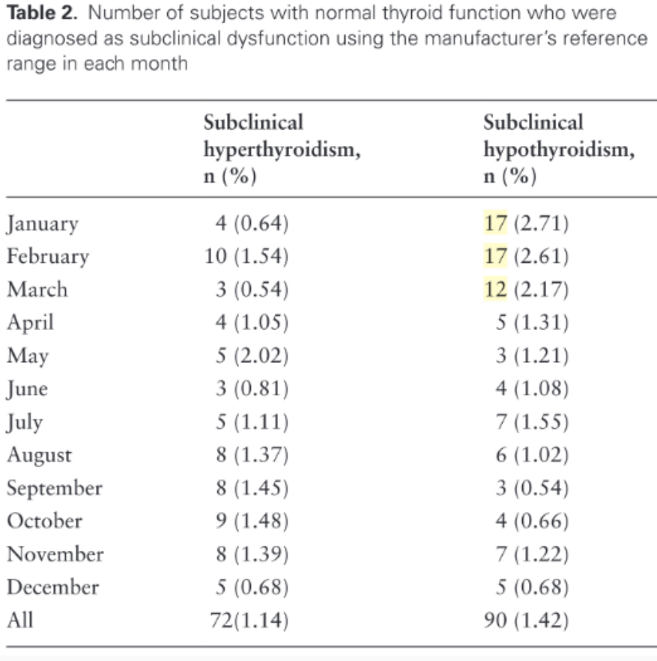
Yamada et al, Figures and Tables
Yamada et al., “Seasonal Variation in Thyroid Function”, Figure 1. Original.

Slide 25
Findings
Implications
Demonstrated TSH: High in winter and Low in summer.
Linked seasonality to subclinical diagnoses (by manufacturer limit)
Identified source of TSH variation not captured by our reference intervals
May lead to false diagnoses & unnecessary prescriptions
Limitations
Scope limited to single year
(Is the effect Stationary year-to-year?)
Controlled for many relevant effect modulating variables
Generalizability – more next slide

Slide 26
Idea 1: Seasonal Calibration
"Just Transform" Data from Yamada et. Al.
Linear "2-point calibration" to map yearly upper and lower reference.
Then, we'll use the same scale factor to derive our month-to-month.

Slide 27
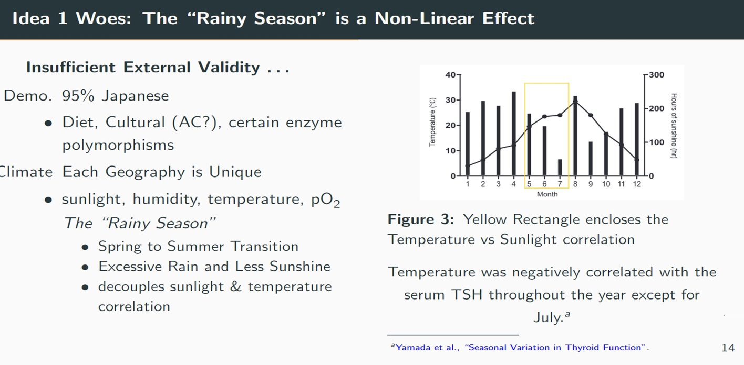
Limits on Direct Comparison
Demographic, diet, enzyme polymorphisms
Effect in each geographic region unique
Sunlight, humidity, temperature, pO2
The "Rainy Season"
Spring to summer transition
Excessive rain, less sunshine
Decouples sunlight and temperature correlation
Temperature (°C)
Sunshine (hours)
ªYamada, S. et al. J Endocr Soc. 2022 PMID: 35528829
Notes:
Prob need to calibrate for each region

Slide 28
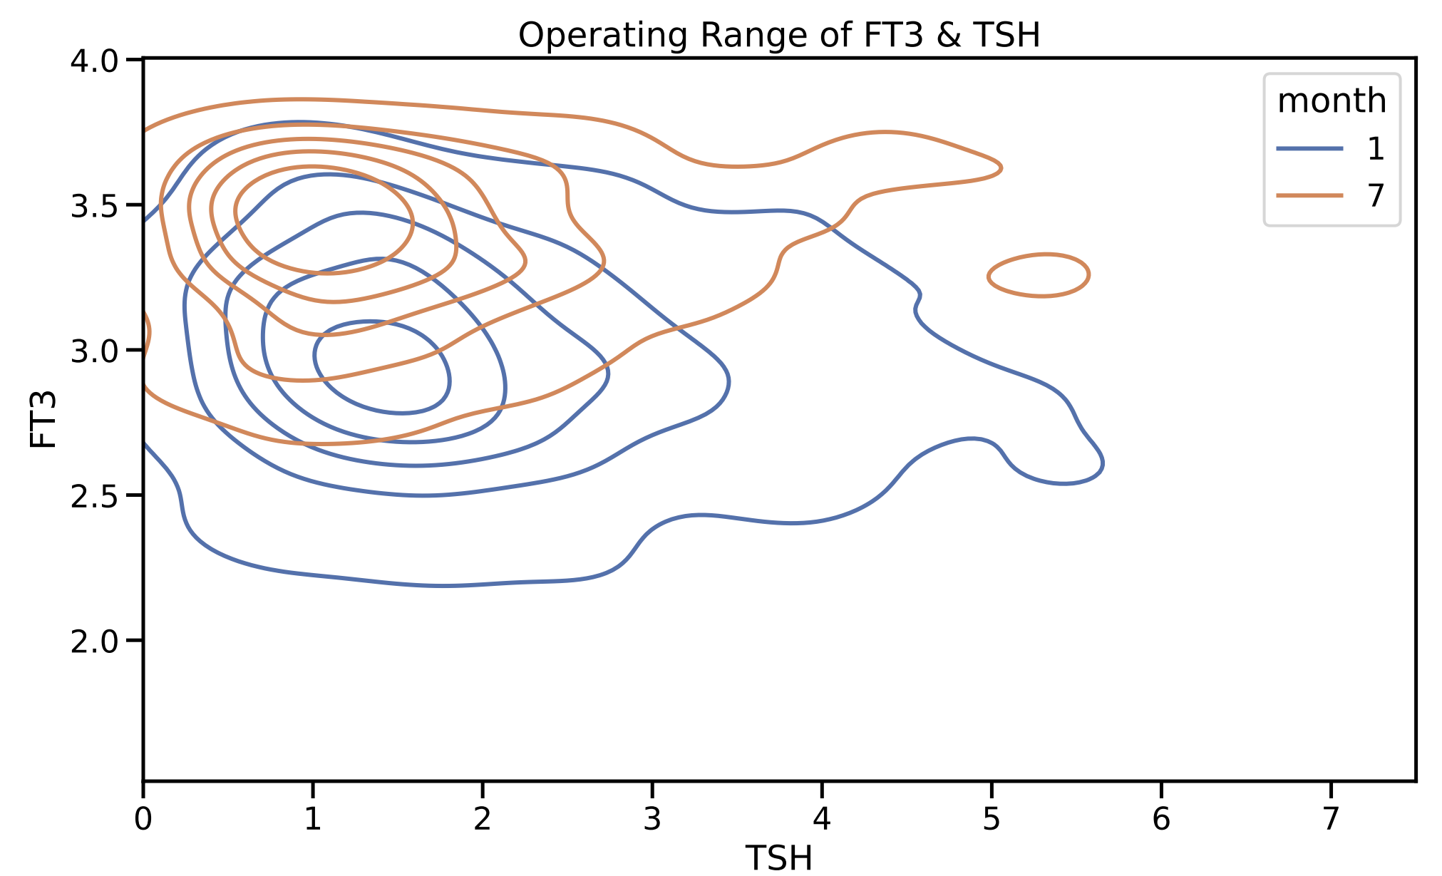
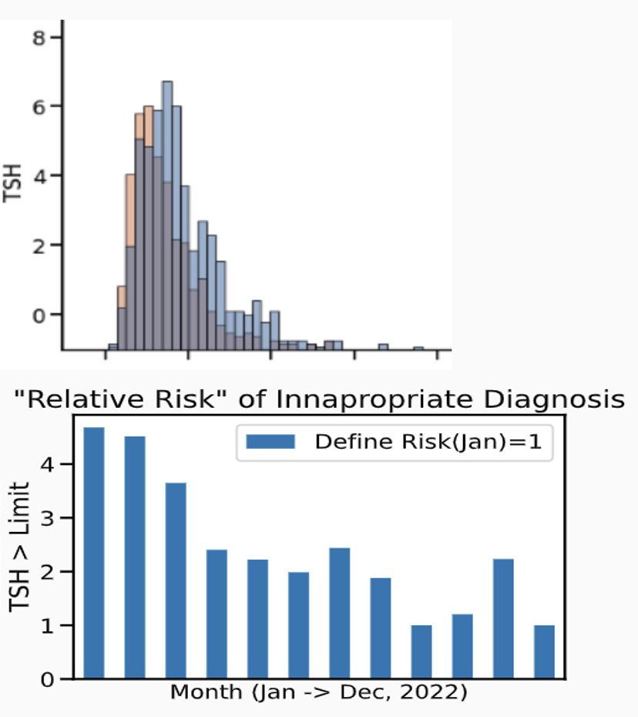
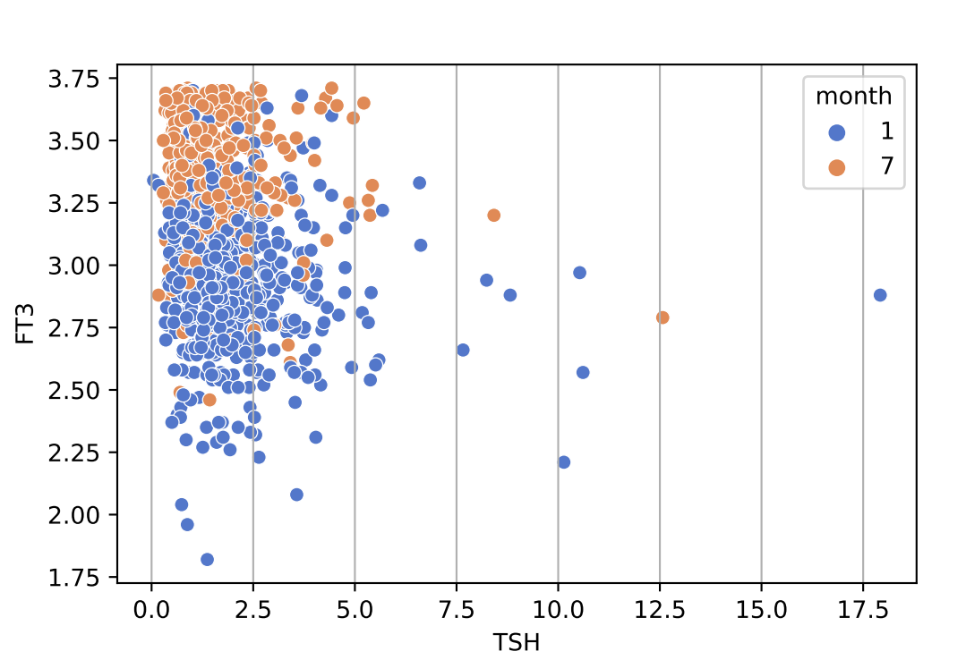
Yamada et al: A Closer Look at the Data
Notes:
Satisfied that the effect was real, albiet in only 1 paper so far, I wanted to assess more closely how Roche formulated their ref interval to see if they considered seasonality as well.

Slide 29
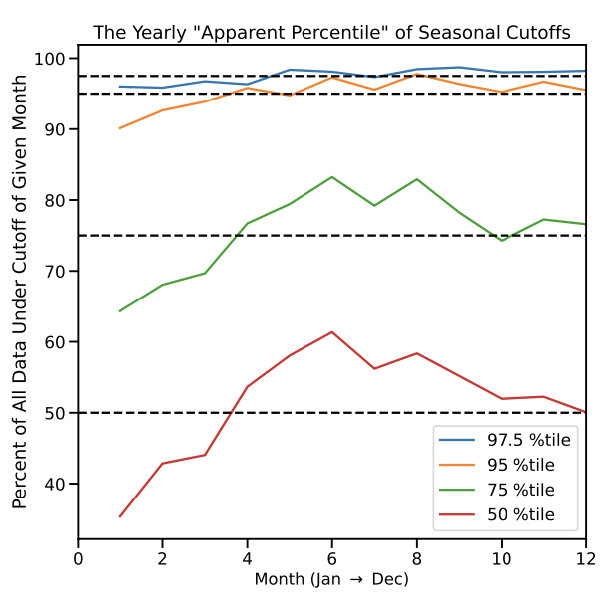
Second Thoughts
Yearly "Apparent Percentile" Seasonal Cutoff
Not a Great Idea
Requested access to Yamada data
Significant monthly variation
Would need to stretch cutoff from yearly 97.5% to 99% for cutoff to cover monthly variation
The false negatives matter
Estimating 99%ile requires more patients than the 95%ile

Slide 30
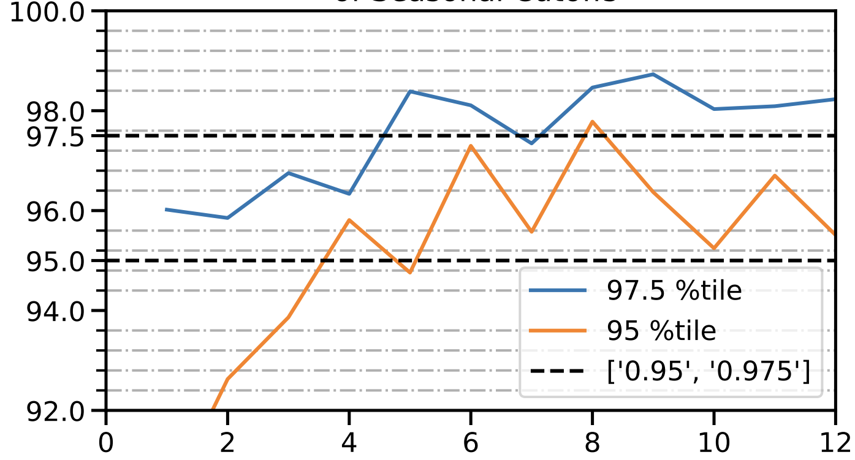
Second Thoughts
Not a Great Idea
Requested access to Yamada data
Significant monthly variation
Would need to stretch cutoff from yearly 97.5% to 99% for cutoff to cover monthly variation
The false negatives matter
Estimating 99%ile requires more patients than the 95%ile
"Apparent Percentile" Seasonal Cutoff
Month of the Year (January to February)

Slide 31
Roche, 2003: TSH (Adult) R.I.
Who?
870 Adults, aged 20-69
Where?
Leipzig, Germany
When?
4 month period (May to August 2003)
TSH: Reference Values (BJH Catalog)
Notes:
The climate in Leipzig is likely to be very different
Unfortunately, all of this patient data was collected during the summer time.
Because L. hg. Latitude, more hours of sunlight than if we had done a summer study.
Confident that I might be on to something, I wanted to make sure that I had the seasonality right.

Slide 32
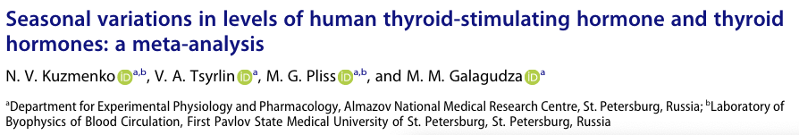
Aims:
To investigate the seasonal dynamics of circulating TSH
in the published reports
Study Design:
Meta-analysis: studies (as of 2020) w/ euthyroid adults
Excluded extreme climates, time-of-day not recorded
1051 → n=20 studies (primarily cross-sectional)
Meteorological data
Kuzmenko, N.V. et al. Chron Int. 2021. PMID: 33535823

Slide 33
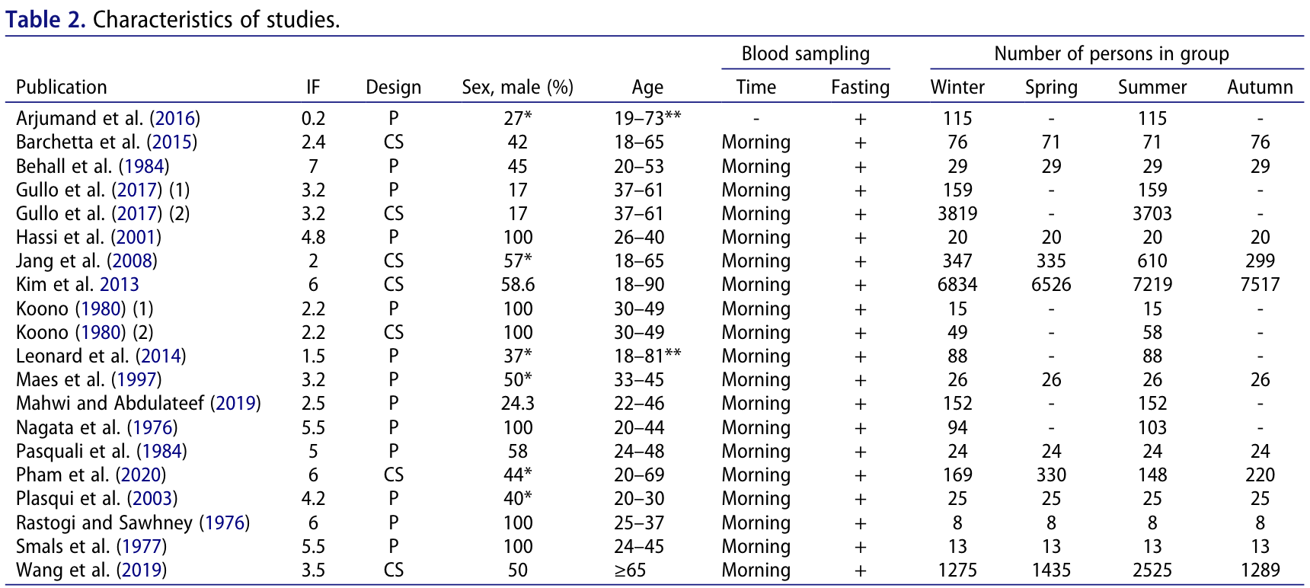

Slide 34
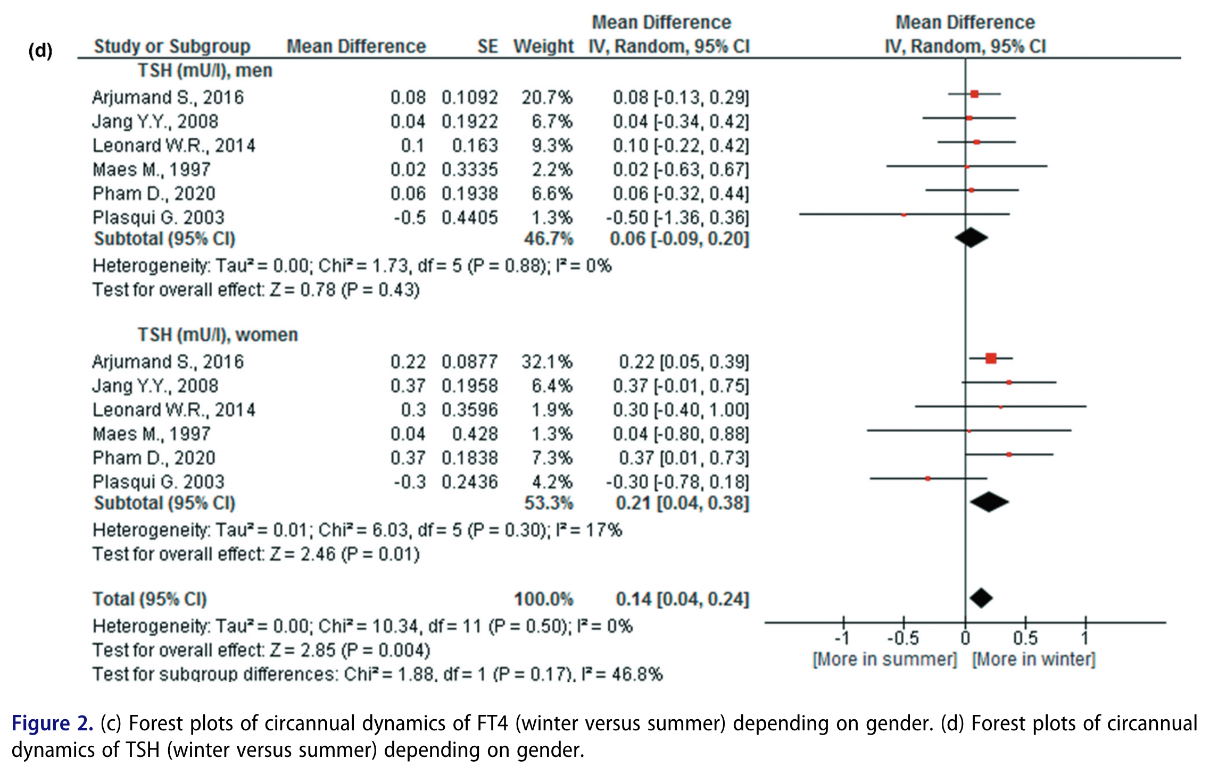
Kuzmenko et al, Findings (1)
TSH, Men
Circulating TSH levels were higher in winter than in the other seasons
TSH, Women
Significant increases in TSH levels during winter in women, but not in men
TSH, Total
More in Summer
More in Winter
Kuzmenko, N.V. et al. Chron Int. 2021. PMID: 33535823

Slide 35
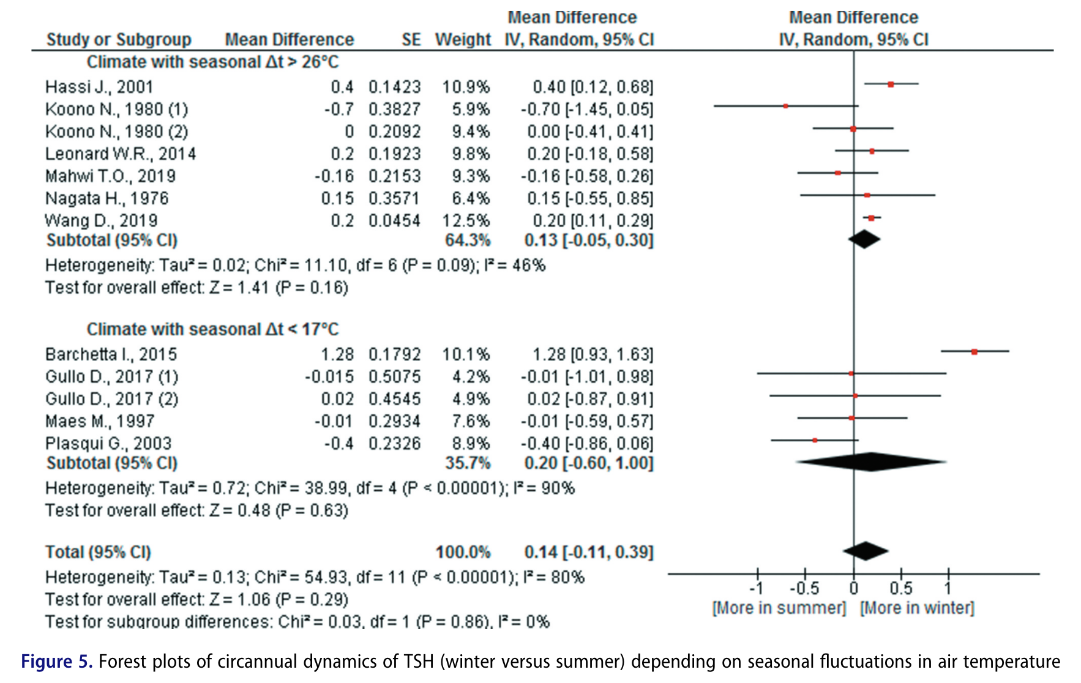
Kuzmenko et al, Findings (2)
TSH, Seasonal ∆T > 26 C
No temperature effect size:
No dependence of TSH on amplitude of seasonal fluctuation in air temperatures
TSH, Seasonal ∆T < 17 C
More in Summer
More in Winter
More in Summer
More in Winter
Kuzmenko, N.V. et al. Chron Int. 2021. PMID: 33535823

Slide 36
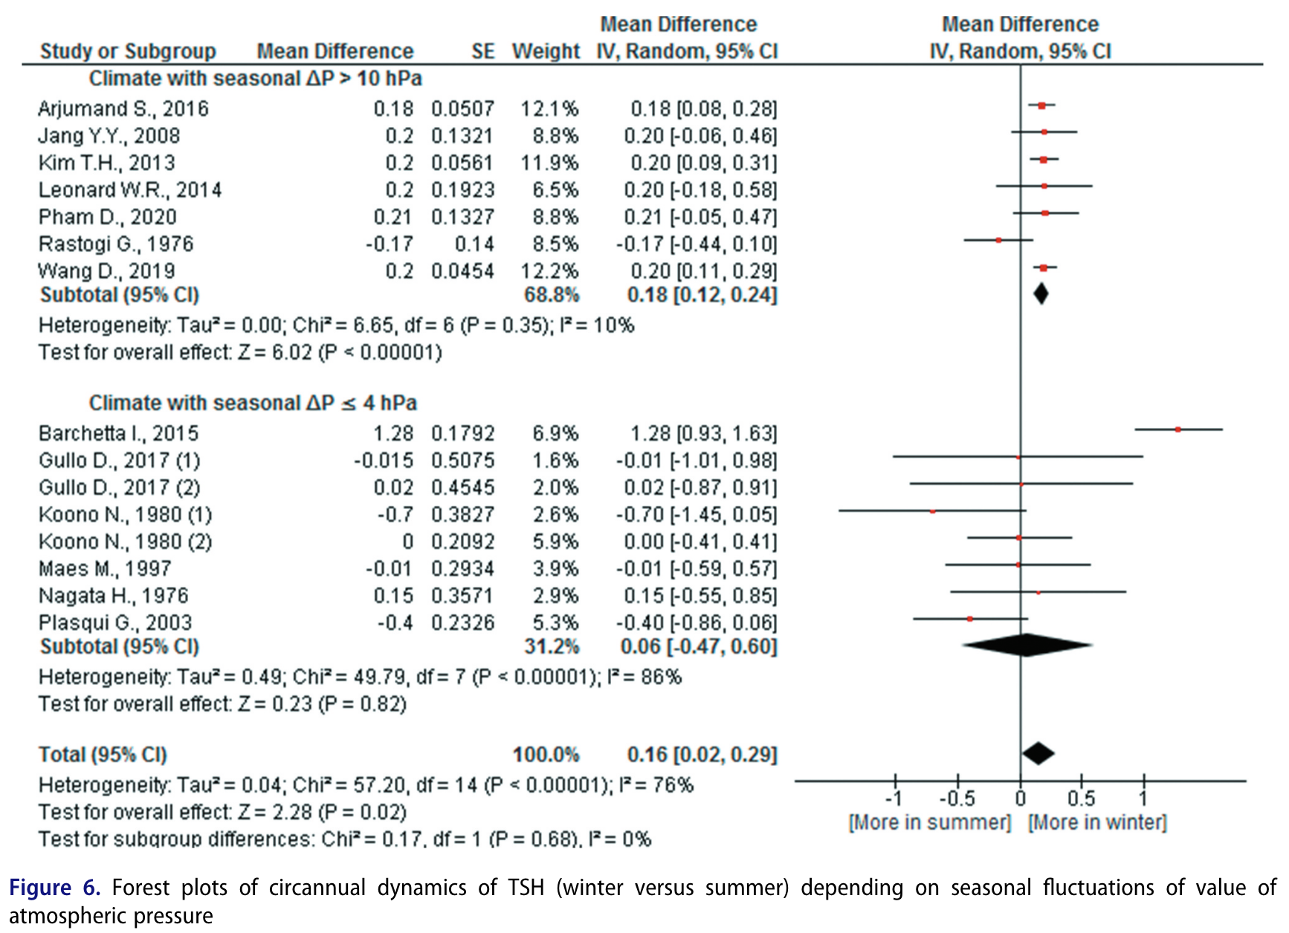
Kuzmenko et al, Findings (3)
TSH seasonal effect magnitude correlates better with seasonal variation in mean monthly atmospheric pressure and ρO2
TSH, Seasonal ∆P > 10 hPa
TSH, Seasonal ∆P < 4 hPa
“seasonal dynamics of TSH is expressed in a climate in which relative humidity is higher in summer than in winter” (Kuzmenko et al., 2021, p. 310) (pdf)
More in Summer
More in Winter
Kuzmenko, N.V. et al. Chron Int. 2021. PMID: 33535823

Slide 37
Kuzmenko et al
Findings
TSH levels higher in winter overall, statistical sig. for women
TSH seasonality higher with…
Increased fluctuation of monthly pO2 and atm pressure
Areas with higher humidity in summer than in winter
Notes:
Greater in bejing than moderna, italy

Slide 38
Kuzmenko et al
Limitations
Underpowered to detect age effect (only 2 of 20 studies)
Meta-analysis restricted to those published in English
Could not trend individuals
(cross-sectional)
Majority of studies not controlled for caloric intake (and iodine)
diet is likely also seasonal and needs further study as a causative factor
Many unclear confounders
all metrological variables influence each other

Slide 39
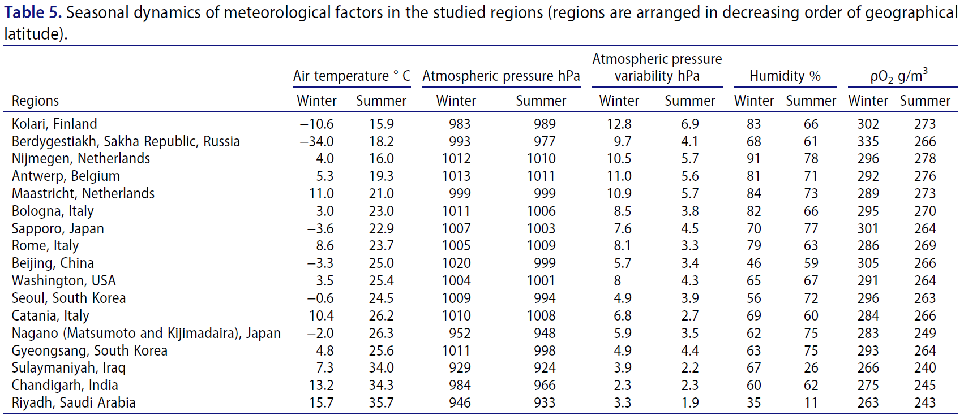

Slide 40
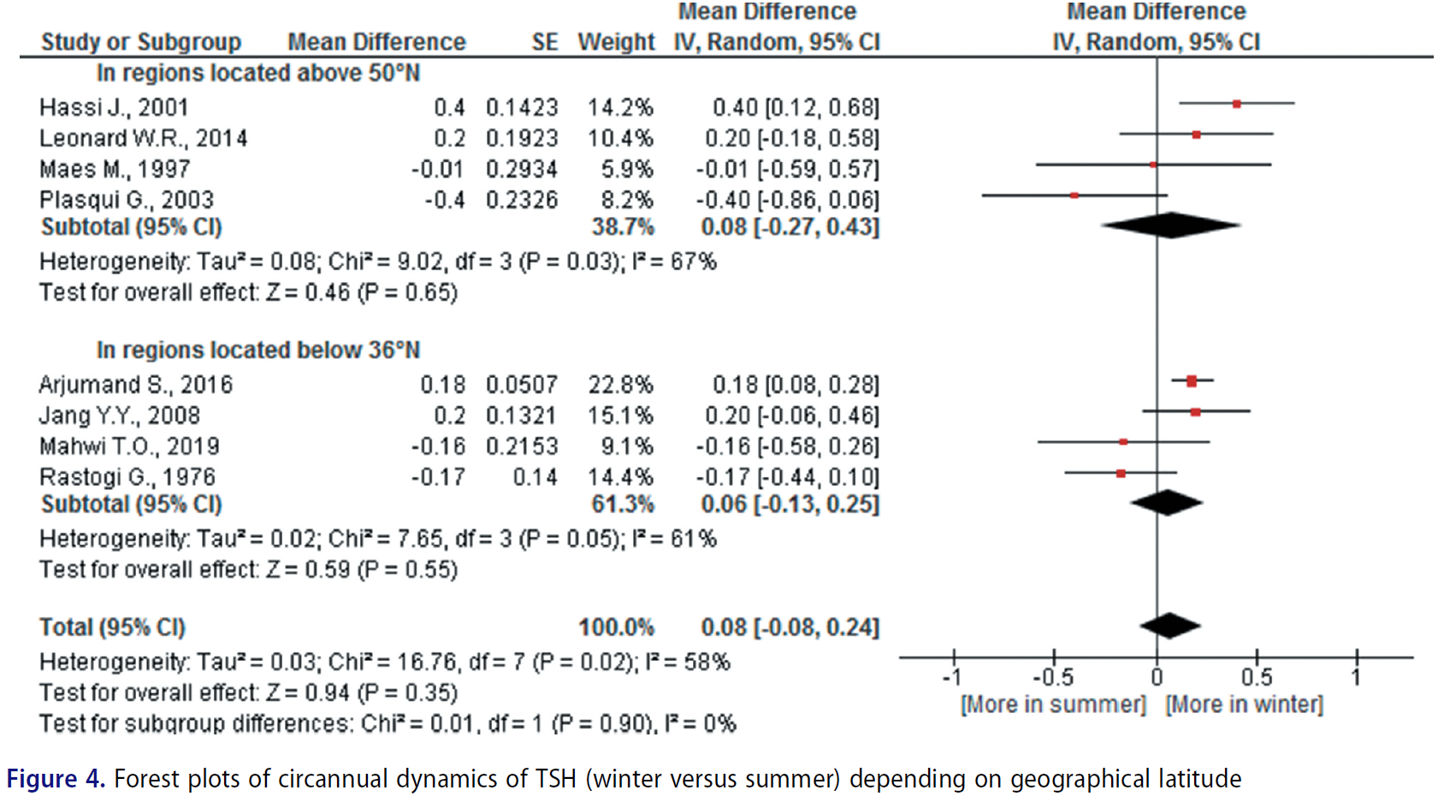

Slide 41
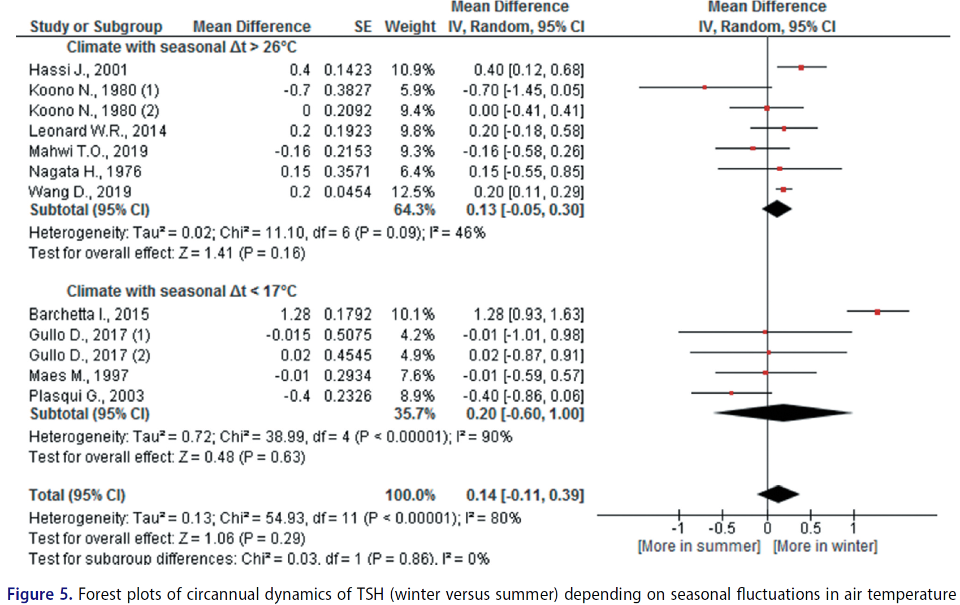
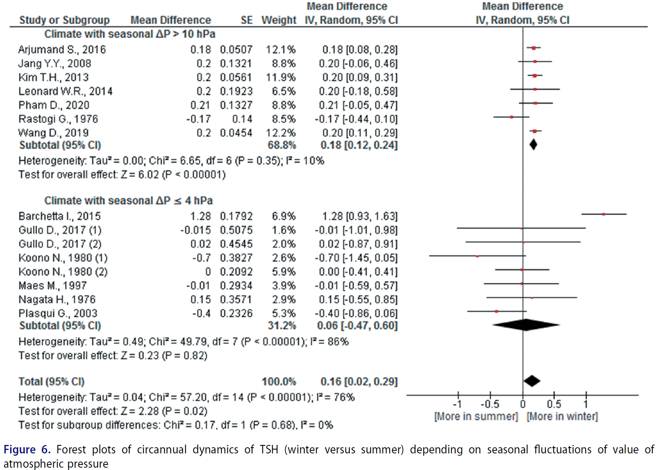

Slide 42
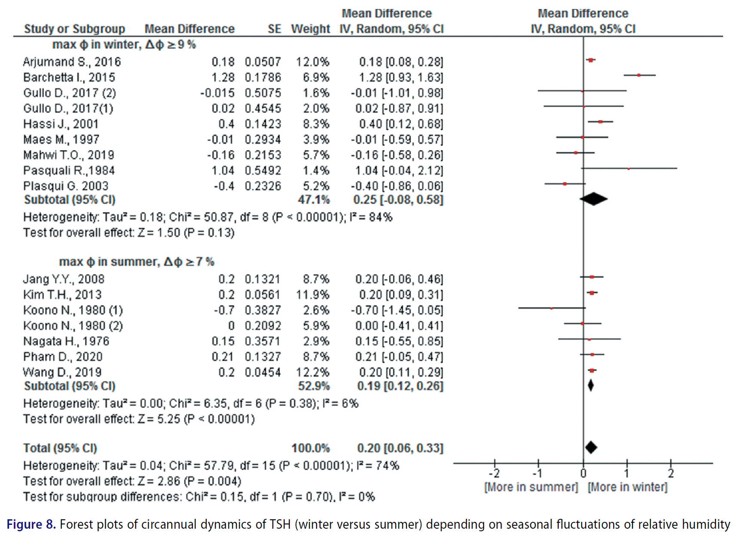

Slide 43
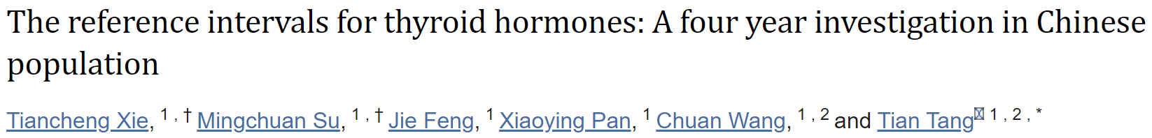
Background
Discrepant thyroid (assoc.) disease prevalence USA (12%^{[1]}) vs China(40%).
Primarily subclinical hypothyroidism
Authors concerned for false elevation.
Manufacturer intervals are widely adopted but based on few samples.
Aims
Determine dynamic trends of serum TSH, T3, FT3, T4 and FT4.
Re-evaluate Manufacturer reference interval validity.
Explore possible roles of age and sex on the levels of biomarkers.
^{[1]} American Thyroid Association
Xie T et al. Frontiers in Endocrinology. 2023. PMID 36686466

Slide 44
Study Design
Cross Sectional Study
Healthy Adults ages 22 - 70 years, 8/2019 - 9/2020
> 66,000 individuals met inclusion criteria
Methodology; Exclusion Criteria
Pregnancy, past of family endocrine history, medications affecting thyroid function
Required patients to fast for 8 hours
TSH measured on Roche Cobas E 601
Xie T et al. Frontiers in Endocrinology. 2023. PMID 36686466
Notes:
As the study
subjects were allowed to choose their health check packages and
different packages included varying numbers of tested thyroid
hormones, it is not surprising that the data size for serum levels of
TSH, T3, T4, FT3 and FT4 are different. Specifically, the TSH level
was determined for all subjects. While the serum level of T3 and
T4 were measured for approximately 54,000 subjects. In
comparison, only 34,000 subjects choose to take all five thyroid
hormones. The sample size of each analyte and the number of
outliers removed are listed in Table 1.
Previous studies create partitions based on age, but do not explain methodology – as in this study which uses Harris & Boyd
For all study participants, 8 hours of fasting were required
before blood sampling. In brief, 3 ml of blood was collected from
each subject using a vacutainer blood collection tube (Sanfeng
Medical Co., Ltd., Chongqing, China). After incubation at room
temperature for 10 min, the serum was isolated by centrifugation
at 3,000 rpm for 10 minutes. The levels of T3, T4, FT3, FT4 and
TSH were determined using a Cobas E 601 automatic electrochemiluminescence
immunoassay analyzer (Roche Diagnostics,
Shanghai, China) with the corresponding Elecsys® detection Kit.
The time interval between sampling and testing was <60 min.
The limits of detection (LOD)/quantification (LOQ) are listed in
Supplementary Table S4.

Slide 45
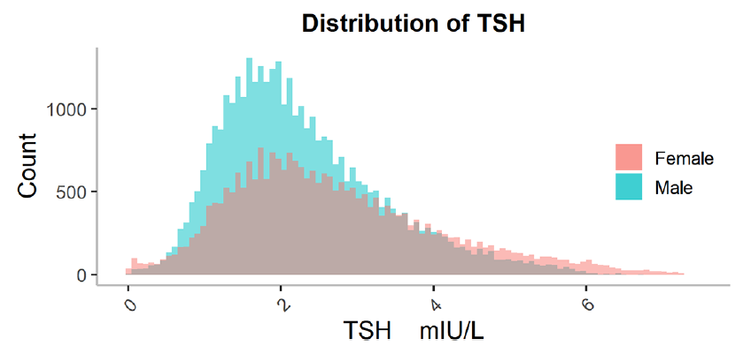
Xie T et al. Frontiers in Endocrinology. 2023. PMID 36686466
Notes:
(left) Median TSH lower in Males than Females ( but no change in RI based on sex?)
(right) TSH minimal variation in males, steady increase for females ages 40-68 years
--proposed explanations: decreased TSH activity, or dec sensitivity of TSH to negative feedback of thyroid hormones, or inc uptake iodine or accelerated organ failure of thyroid tissue in females
Data analyzed with CLSI-C28-A3 Guidelines

Slide 46
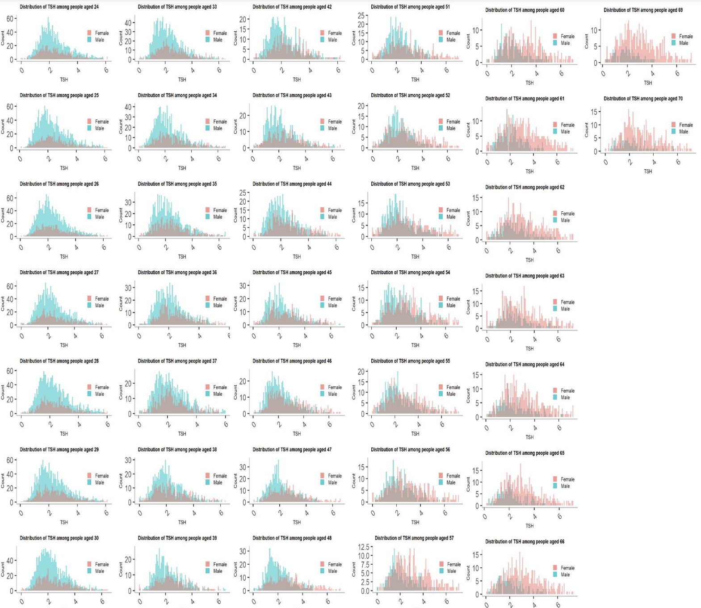
Xie T et al. Frontiers in Endocrinology. 2023. PMID 36686466
Notes:
Available histograms- each plot is a diff age (years), colors mean same as previous (male vs female)

Slide 47
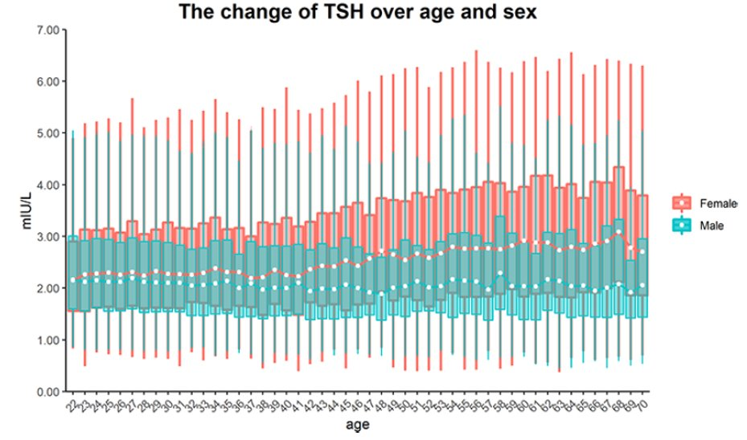
The Change of TSH over Age and Sex
7.00
6.00
5.00
4.00
3.00
2.00
1.00
Female
Male
TSH (mIU/L)
22 30 40 50 60 70
Age (years)
Xie T et al. Frontiers in Endocrinology. 2023. PMID 36686466
Notes:
Compound effect Age and Gender more closely

Slide 48
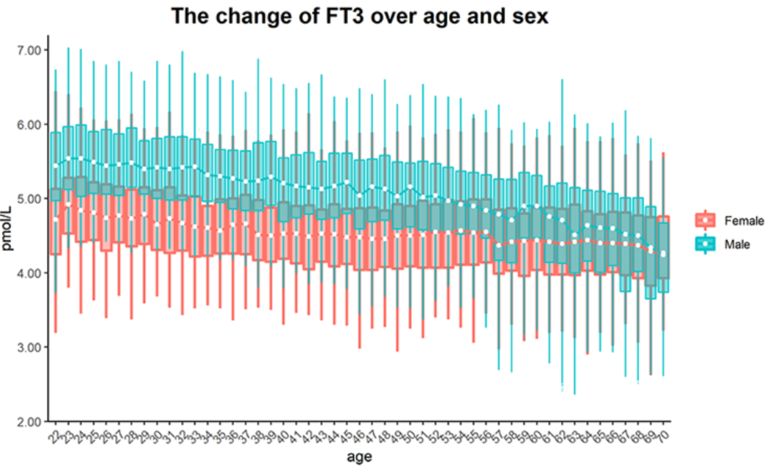
The Change of FT3 over Age and Sex
7.00
6.00
5.00
4.00
3.00
2.00
1.00
Female
Male
FT3 (mIU/L)
22 30 40 50 60 70
Age (years)
Xie T et al. Frontiers in Endocrinology. 2023. PMID 36686466

Slide 49
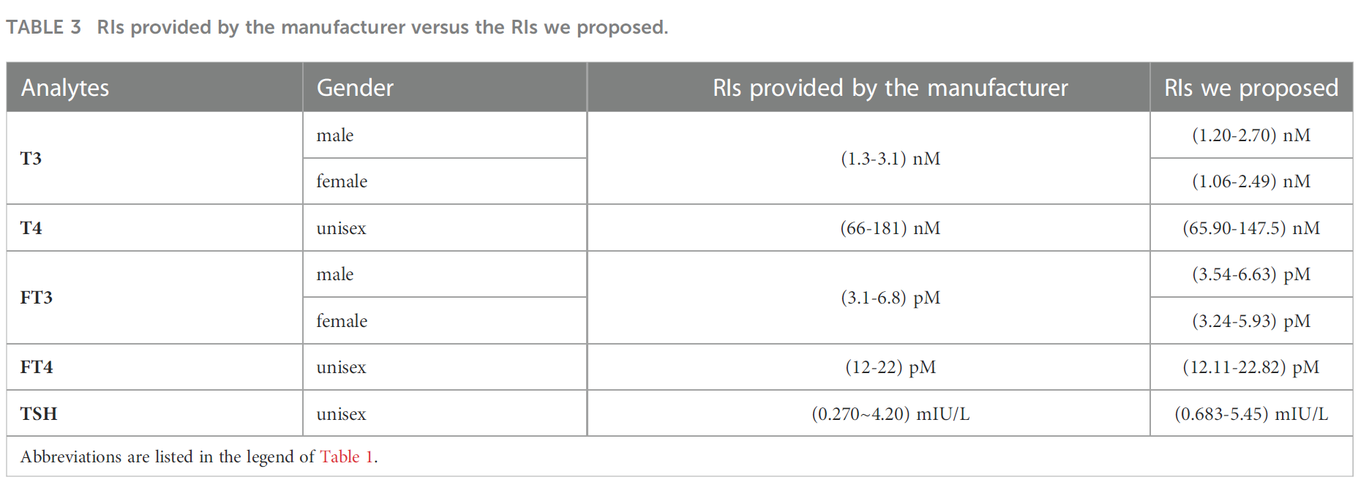
Conclusion from Measuring Local Ref. Interval (same assay and manufacturer we use)
manufacturer ​ ​ proposed by Xie et al.
0.270 - 4.20 miU/L​
0.683 - 5.45 miU/L
Package Insert: Thyrotropin TSH. Roche Corporation 04/2021.
Notes:
Data were analyzed in accordance with CLSI C28-A3
guidelines (7). Statistical analysis was implemented using R
studio Ver. 4.0.5 or EXCEL Ver. 16.65. In brief, the frequency
histograms of each biomarker were used to visually inspect the
data. Outliers were identified using Tukey’s tests and removed.
The normality of the data was determined by the Shapiro−Wilk
test. The RIs of each biomarker were partitioned by the Harris
& Boyd approach (7); if the results did not suggest partitioning,
the data were combined and re-estimated. The nonparametric
rank method was used to calculate the 0.5th, 2.5th, 25th, 50th,
75th, 97.5th and 99.5th percentiles of each reference partition.
The central 95% interval, corresponding to the range between
the 2.5th and 97.5th percentiles, was defined as the RI. For each RI, the 90% confidence intervals were calculated for the
end points.
3

Slide 50
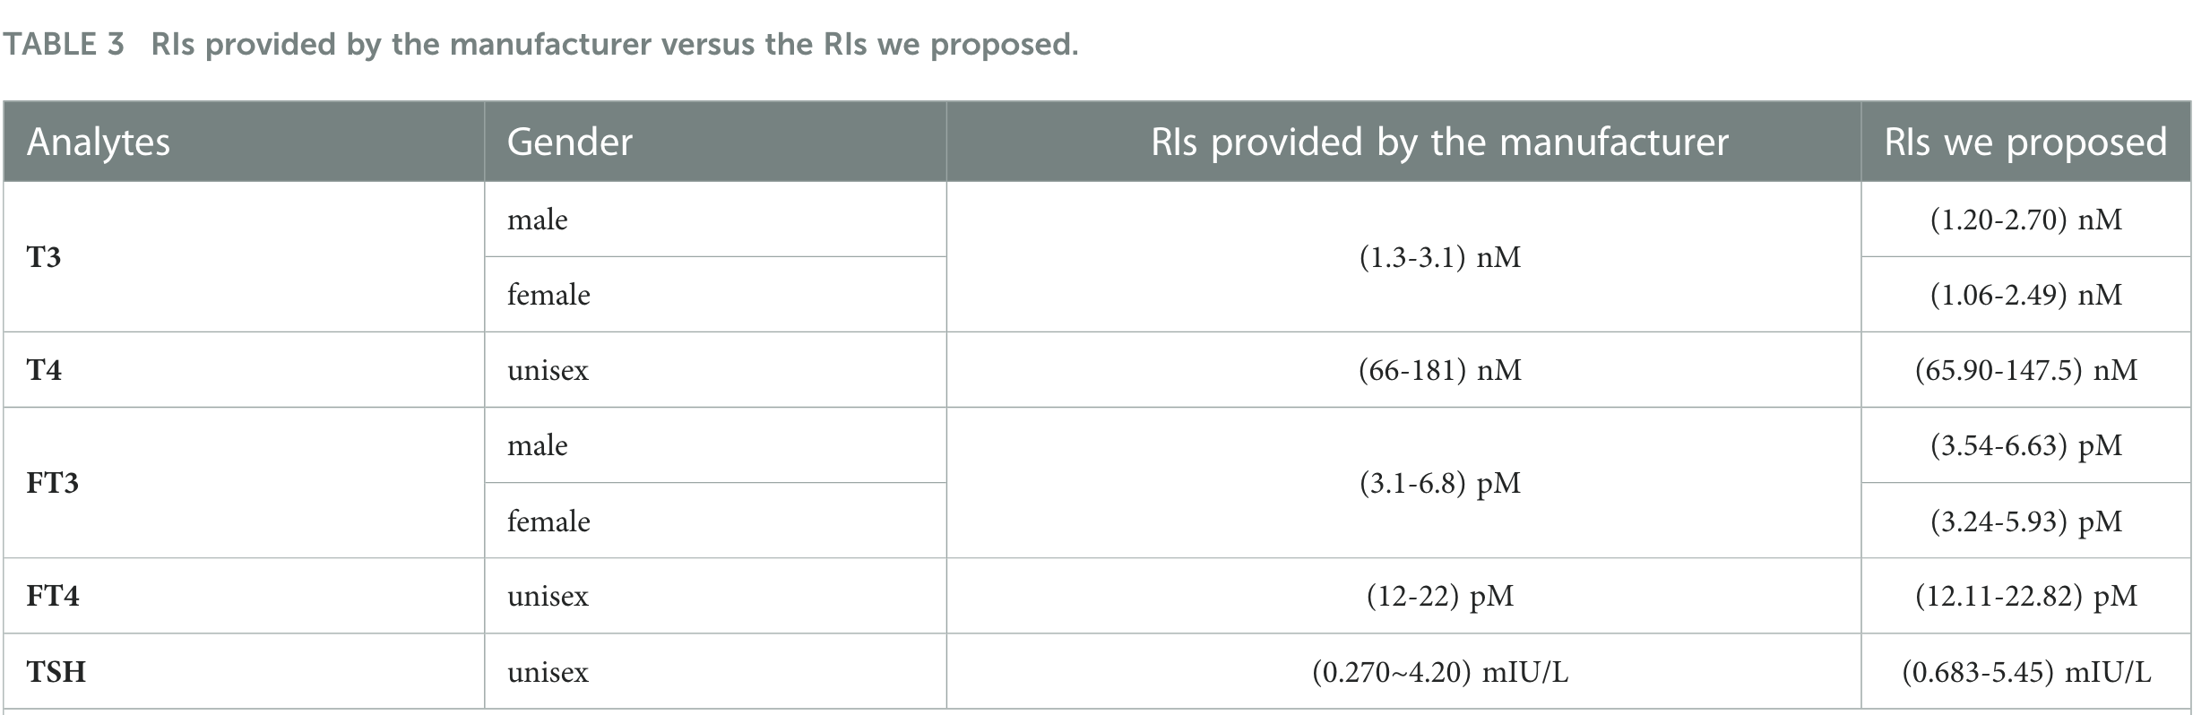
Conclusion from Measuring Local Ref. Interval (same assay and manufacturer we use) manufacturer proposed by Xie et al.
0.270 - 4.20 miU/L​
0.683 - 5.45 miU/L
Package Insert: Thyrotropin TSH. Roche Corporation 04/2021.
Notes:
Data were analyzed in accordance with CLSI C28-A3
guidelines (7). Statistical analysis was implemented using R
studio Ver. 4.0.5 or EXCEL Ver. 16.65. In brief, the frequency
histograms of each biomarker were used to visually inspect the
data. Outliers were identified using Tukey’s tests and removed.
The normality of the data was determined by the Shapiro−Wilk
test. The RIs of each biomarker were partitioned by the Harris
& Boyd approach (7); if the results did not suggest partitioning,
the data were combined and re-estimated. The nonparametric
rank method was used to calculate the 0.5th, 2.5th, 25th, 50th,
75th, 97.5th and 99.5th percentiles of each reference partition.
The central 95% interval, corresponding to the range between
the 2.5th and 97.5th percentiles, was defined as the RI. For each RI, the 90% confidence intervals were calculated for the
end points.
3

Slide 51
Xie et al
Implications
Large difference between manufacturer and own RI.
Established significant age- and sex- effects on TSH.
Function indicators, based on CLSI EP28-A3c guidelines.
Notes:
7. Horowitz GL, Altaie S, Boyd JC, Ceriotti F, Garg U, Horn P, et al. Defining,
establishing, and verifying reference intervals in the clinical laboratory; approved
guideline. 3rd ed. USA: CLSI and IFCC (2010) p. 12–20.

Slide 52
Xie et al
Implications
Established age- and sex-stratified RIs for thyroid function indicators, based on CLSI EP28-A3c guidelines.
Limitations
Inclusion/exclusion criteria offset by large data sample
Does not account for cofactors
e.g. iodine intake, ethnicity, climate, seasonal changes
Did not specify time of day samples were taken
Notes:
7. Horowitz GL, Altaie S, Boyd JC, Ceriotti F, Garg U, Horn P, et al. Defining,
establishing, and verifying reference intervals in the clinical laboratory; approved
guideline. 3rd ed. USA: CLSI and IFCC (2010) p. 12–20.

Slide 53
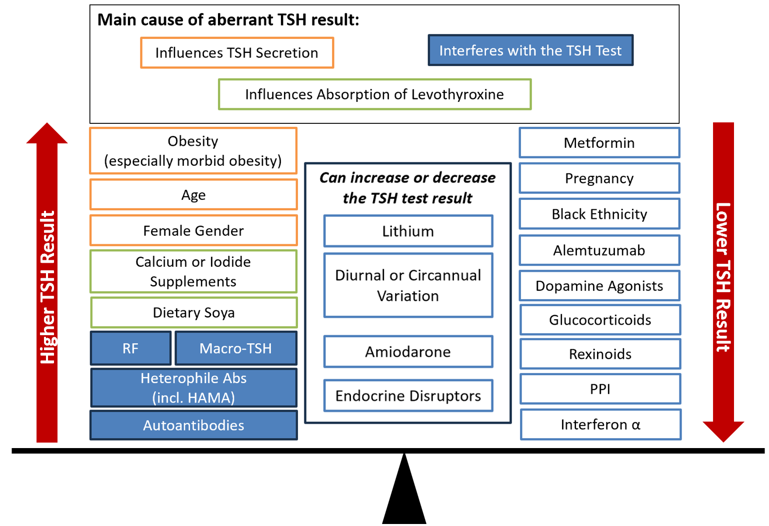
To Recap
Non-Seasonal Modifiers of TSH
It’s complicated
A range of promising steps

Slide 54
To Recap
Non-Seasonal Modifiers of TSH
It’s complicated
A range of promising steps
I see value in :
Doing an informatic sanity check of Roche RI
A Null Interval that knows about 1 to N factors

Slide 55
To Recap
Non-Seasonal Modifiers of TSH
It’s complicated
A range of promising steps
I see value in :
Doing an informatic sanity check of Roche RI
A Null Interval that knows about 1 to N factors
One worries about:
Whether is it even possible to make so many corrections

Slide 56
Null Intervals vs Reference Intervals:
“Null Intervals”
“Reference Intervals”
*
TSH
Checkup
Checkup
Inpatient
Inpatient
Notes:
Which is the more appropriate interval for comparison?

Slide 57
Null Intervals vs Reference Intervals:
The Difference in TSH Interpretation (illustrative data)
“Null Intervals”
“Reference Intervals”
TSH
*
Summer
Fall
Winter
Fall
Winter
Summer
Notes:
Which is the more appropriate interval for comparison?

Slide 58
Null Intervals vs Reference Intervals:
The length of the 95% interval is Variable!
“Null Intervals”
“Reference Intervals”
*
TSH
*
Inpatient
Inpatient
+ ldopa
Checkup
Inpatient
Checkup
Notes:
Which is the more appropriate interval for comparison?
Produces the shortest interval that captures 95% of data

Slide 59
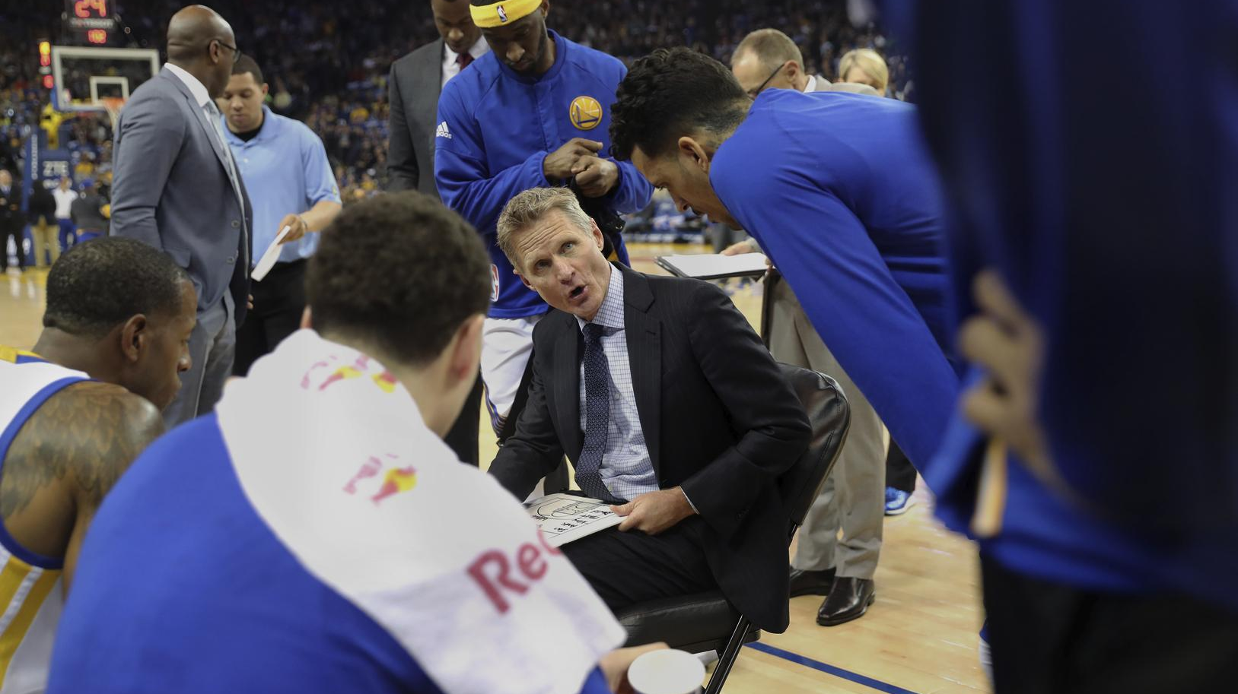
M-A-T-H
Notes:
Audience apprehension about math
Audience suspicion that I am making it more complicated than it needs to be

Slide 60
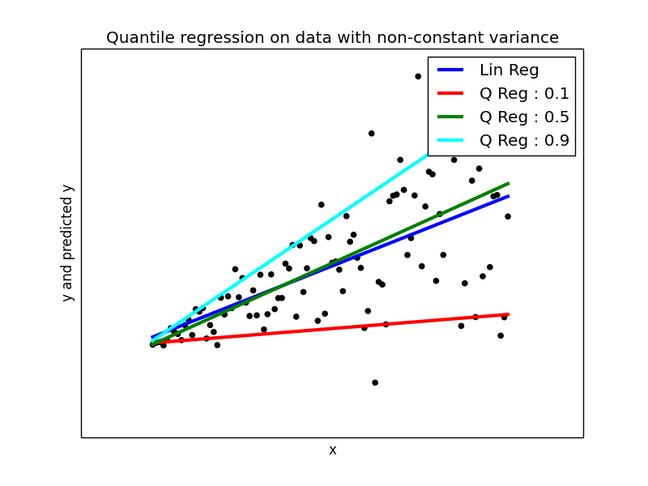
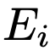
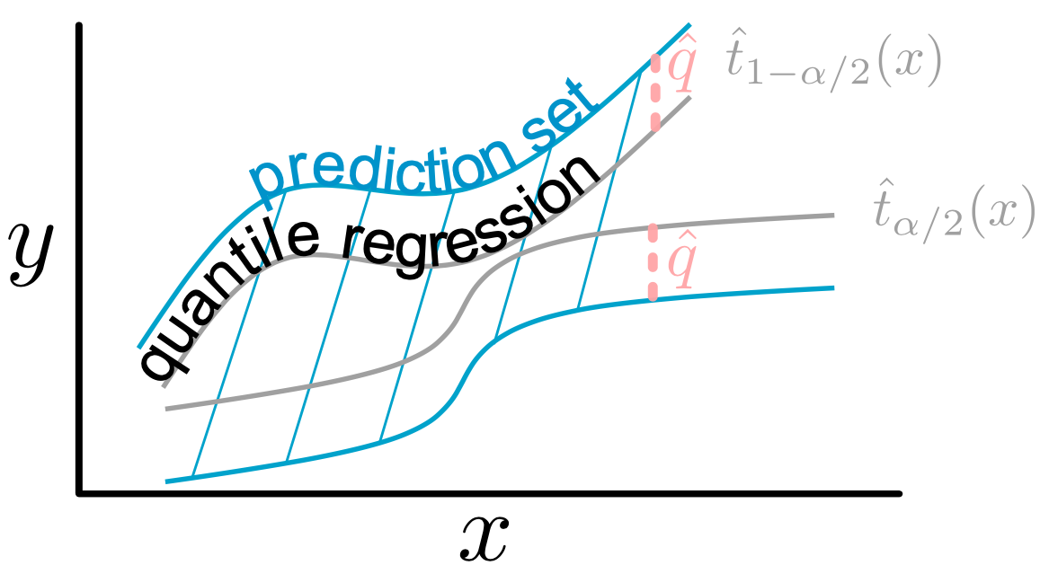
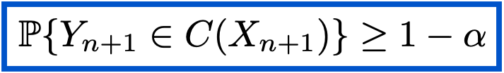
Quantile Regression:
Ei
E_{i} := max{ q_{lo} (X_{i}) − Y_{i} , Y_{i} − q_{hi} (X_{i}) }
“1 Simple Trick”
Curve fitting adapted to percentiles!
Bates. A Gentle Introduction to Conformal Prediction and Distribution-Free Uncertainty Quantiﬁcation. 2022
Compensate prediction intervals by adding
"telomeres" = Quantiles (residuals)

Slide 61
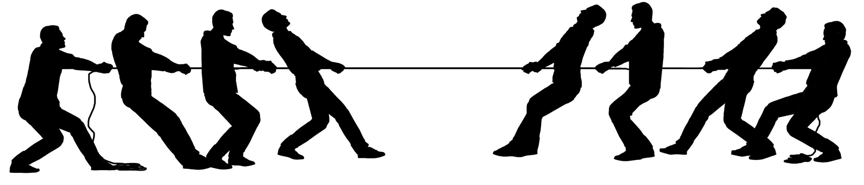
Quantile Regression:
Ei
E_{i} := max{ q_{lo} (X_{i}) − Y_{i} , Y_{i} − q_{hi} (X_{i}) }
What is a median (0.50 Quantile)
Q₅₀
Bates. A Gentle Introduction to Conformal Prediction and Distribution-Free Uncertainty Quantiﬁcation. 2022
Compensate prediction intervals by adding
"telomeres" = Quantiles (residuals)

Slide 62

Quantile Regression:
Ei
E_{i} := max{ q_{lo} (X_{i}) − Y_{i} , Y_{i} − q_{hi} (X_{i}) }
4x
1x
1x
1x
1x
Q₈₀
"pinball" or "check" function
Compensate prediction intervals by adding
"telomeres" = Quantiles (residuals)

Slide 63
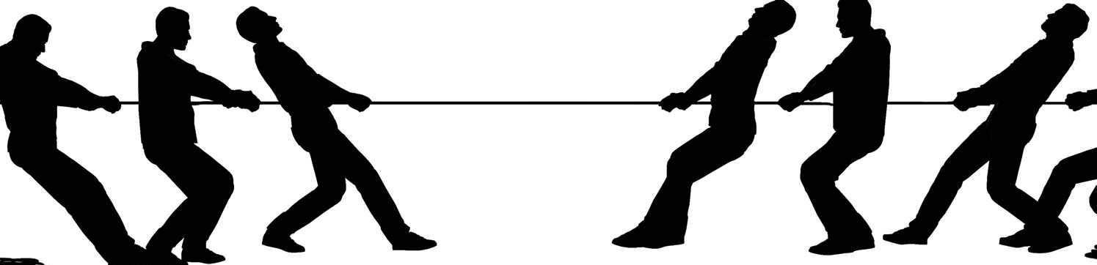

Quantile Regression in context
Mean
Median
Quantile
Slope (1-α) or α​
Notes:
x̂

Slide 64





Quantile Regression
Roche used this technique in 2009 to model 97.5%-tile of TSH
Age-Dependent Estimates
No binning needed
What can go wrong?
10
TSH (uIU/ml)
5
Female
0
10
20
Age (years)
60
70
Roche, 2009. Reference Intervals for Children and Adults.

Slide 65


Model Criteria: Accommodate Heteroskedasticity
Not "Most likely[Y|X] plus noise"
Y ∈ q₅₀(X) ± σ
σ needs dependence on X too!
Yamada data request, 2023

Slide 66

Quantile Regression Limitations
“Overfitting”
“Over-Confident” models produce intervals that are too short!
Neural networks especially prone to this
Notes:
New Problem?
(vs 1-D Ref. Interval Case)

Slide 67
Quantile Regression Limitations
“Overfitting”
“Over-Confident” models produce intervals that are too short!
Neural networks especially prone to this
Want:
Notes:
New Problem?
(vs 1-D Ref. Interval Case)

Slide 68

Conformal Prediction:
Ei
E_{i} := max{ q_{lo} (X_{i}) − Y_{i} , Y_{i} − q_{hi} (X_{i}) }
>1000 citations/year since 2019
"user-friendly paradigm for creating statistically rigorous uncertainty sets"
Bates. A Gentle Introduction to Conformal Prediction and Distribution-Free Uncertainty Quantiﬁcation. 2022
Compensate prediction intervals by adding
"telomeres" = Quantiles (residuals)
Notes:
valid in a "distribution-free sense"
(No "Limit Theorems")
use with any pre-trained model (NNet)
Guarantee: sets contain ground truth with user-specified probability

Slide 69

Conformal Prediction: Limitations
All models will satisfy 95% criteria
Not all models are equal
Many useful extensions:
Can limit false discovery rate
Can adapt to climate drift
A Gentle Introduction to Conformal Prediction and Distribution-Free Uncertainty Quantiﬁcation. 2018

Slide 70

Conformal Prediction: Prediction Length
All calibrated models have the Same Coverage
Surely, some are "better"?
Short Interval Length
• Easier to reject H0
• Detects more anomalies
• Length(C(X)) = 0 in deterministic limit
Fig 2. Emmanuel J. Candès. Conformalized Quantile Regression. 2019
red for split conformal, in gray for locally adapative split conformal, and in light blue for our method

Slide 71

Machine Learning
Fig. 2. Graphical representation of types of machine learning models: (A) a simple decision tree and (B) deep learning neural network.

Slide 72
Conformal Prediction: Model Calibration
held-out validation set
"reference intervals for residuals":
Compensate prediction intervals by adding
"telomeres" = Quantiles (residuals)
Notes:
Ei := max{ qlo (Xi) − Yi , Yi − qhi (Xi) }

Slide 73

Conformal Prediction
A method for taking any heuristic notion of uncertainty from any model and converting it to a rigorous one.
How is it possible to construct a statistically valid prediction set even if the heuristic notion of uncertainty of the underlying model is arbitrarily bad?

Slide 74

Quantile Regression: Limitations
α=0.95
α=0.05

Slide 75

Fisher Notes
Random variables z1,z2,... are independently drawn from a normal distribution with unknown mean and variance. 1935 by R. A. Fisher
95% prediction interval for zn based on z1,...,zn−1
too weak to be interesting from a modern machine-learning perspective

Slide 76
In Summary
General expected elements of LGM presentations are either required for CME or intended to help you grow as a speaker
Optimize learning for you and the audience, and have fun!

Slide 77
Summary of Recommendations
Better quantification of population TSH values is a high-impact area with low hanging fruit.
It has been >20 years since the Roche RI study.
It’s clear that there is some real exogenous effect on TSH, but the driving factors are not crystal clear.
It’s well worth looking into seasonal variation, but it will be difficult to know what to look for.
An AI model serves as a good positive control for finding nebulous signal.
Recent advances in AI allow true null hypothesis modeling—clinically relevant.

Slide 78
Weighing Benefits and Risks
Risks
Implementation – physician trust of data
Challenges
Accurate labeling and data
Technical
Computational infrastructure
Personnel with the right expertise
Benefits​
Improved diagnosis and
improved outcomes
Low cost after initial set-up

Slide 79
Cost Savings

Slide 80
Current Systems and Proposed Changes
What is a normal TSH?
What is a normal TSH for you?
Notes:
https://ij-healthgeographics.biomedcentral.com/articles/10.1186/1476-072X-12-11
This work continued with Luo et al. [15], who conceived a clinical decision support tool capable of predicting laboratory test results from related laboratory results and other clinical information. As a proof of concept, they demonstrated a machine learning algorithm that was capable of predicting whether serum ferritin level was abnormal with considerable accuracy—achieving an AUROC of 97% using a random forest imputation method to fill in required missing laboratory features that were then fed into a logistic regression model. Meanwhile, Lidbury et al. [22] also studied the redundancy of laboratory test panels, with a focus on liver function tests. They were able to predict whether ɣ-glutamyl transferase (GGT) was normal or abnormal using other components of the liver function panel, achieving an accuracy of 90% with a tree-based machine learning model. They concluded that GGT offered little additional value beyond the other components of a typical liver function panel.
Along similar lines of test result prediction and lab utilization, Xu et al. [23] studied a machine learning model to predict laboratory test results as normal or abnormal in order to identify low-yield, repetitive laboratory tests. Their group performed a multi-site study of nearly 200,000 inpatient laboratory testing orders to identify the most repetitive laboratory tests, and then attempted to predict each one. They were able to achieve an AUROC of > 90% for 20 common laboratory tests including sodium, hemoglobin, and lactate dehydrogenase. They proposed a sensitive decision threshold pertaining to a negative predictive value of 95% to power a clinical decision support tool aimed at reducing low-yield, repetitive testin
https://www-sciencedirect-com.beckerproxy.wustl.edu/science/article/pii/S0009912022000595

Slide 81





Made Possible by
Dr. Farnsworth, PhD
Dr. Gronowski, PhD
Dr. Zaydman MD, PhD
Dr. El-Khoury, PhD (left)
Dr. Amy Riek, MD (right)

Slide 82
Thank you!

Slide 83
What Makes a Lab Value Informative?
Uncertainty Quantification.
Significance is relative to a prior (H0) model
H0 depends on what you know!
*
Measurement
Prior Belief (H0)
~"reference interval"
In diagnostic setting
NACB calls for reference range of 0.2 − 10.0 for inpatients

Slide 84
Analogy with “Instrument Diagnosis”
*
Samples with known concentrations are measured
Which is the more appropriate interval for comparison?

Slide 85
“Pre-Clinical”
affects measurement
presumed clinically uninformative
known at time of measurement

Slide 86
Sources of Laboratory Variation
"Laboratory Error" Degrades Clinical Predictive Value
Pre-Analytical*
Analytical
Approach: Process Control and Measurement Calibration
patient preparation specimen collection
interference
malfunction
adjusting a device or measuring instrument so that its readings are correct within a specified tolerance
Notes:
Insight: Measurement can be assumed independent of clinical processes

Slide 87
Sources of Laboratory Variation
"Laboratory Error" Degrades Clinical Predictive Value
Pre-Analytical*
Analytical
Approach: Process Control and Measurement Calibration
Are there uncontrollable sources of variation?
patient preparation specimen collection
interference
malfunction
adjusting a device or measuring instrument so that its readings are correct within a specified tolerance
Notes:
Insight: Measurement can be assumed independent of clinical processes

Slide 88
"Pre-Clinical"
Preclinical Variation: Unavoidable, measurement variation caused by benign circumstances of measurement and benign patient characteristics.
Timing of measurement (of year)
Gender/Age of patient
Seasonality
Diet
Notes:
Preclinical Error: Medical inference from data consistent with Preclinical Variation

Slide 89
"Pre-Clinical"
Preclinical Variation: Uncontrollable influence on measurement or sample of patient timing or trait consistent with healthy variation
Gender
Seasonality
"Normal Variation" within a Reference Population
Approach: Uncertainty Control Characterization
Notes:
Preclinical Error: Medical inference from data consistent with Preclinical Variation

Slide 90
Causes of Error | Observable​ | Hidden​
Modifiable​ | ​Standardization Calibration | ​—
Intrinsic​ | ? X ? | Reference Intervals​
I propose that modeling Observable Intrinsic sources of variation in TSH would reduce overdiagnosis by reflecting preclinical variation
I propose a ML model for for patient-specific uncertainty that avoids (costly) patient stratification using two key, recent AI modeling paradigms.
Notes:
I propose "coverage intervals"
"calibrate reference intervals" to patient and preclinical data

Slide 91
LGM Grand Rounds Local (WUSM/BJH) application
Think like a director:
Should the lab’s practice actually change based on this information?
Weigh the benefits against the risks/costs
Benefits - improved diagnostic accuracy or treatment?
Risks/costs:
Provide monetary information (cost of test, etc.)
Provide historical test utilization (e.g. # tests/year)

Slide 92
Setup:
TSH measurement Y
Side Information X
p variables time of day, season of year, age, Rx, admitted?…

Slide 93
Setup:
Learn from n previous from the same population...
(X₁,Y₁),…,(X_{n},Y_{n})
TSH measurement Y
Side Information X
p variables time of day, season of year, age, Rx, admitted?…

Slide 94
Criteria for Model:
Answer
"is Y_{n+1} consistent with X_{n+1}?"
B. Provably Correct
"at least 95% of the time"

Slide 95

Model Assumptions:
For each encounter measuring TSH
"is Y_{n+1} consistent with X_{n+1}?"
"at least 95% of the time"
encounters measuring TSH := (Xn+1,Yn+1)​
⇐ X_{n+1} predicts Y_{n+1} (no new information)
Y_{n+1} is in prediction set C(X_{n+1}) except for at most 5% of the time

Slide 96

Model Criteria: Make no Assumptions
Beware Dimensionality
No assumptions about dependence of TSH (Y) on features (X)
Avoid "Curse of Dimensionality"
Fit q(Y|X) instead of q(X,Y) (Favor prediction>inference)
Use:
p >> n

Slide 97


Model Criteria: Output = Interval
Not a straight forward prediction problem
Model Interval using two models
TSH Conditional Percentile q_{α}(X)
q_{α}(X) ~ NeuralNet_{α}(X, parameters)

Slide 98
Model Criteria: Output = Interval
"Coverage Interval" C(X)
Set α = 0.05 α_{low}=α/2, α_{high}=1-α/2
C(X)=[q_{α-low}(X) , q_{α-high}(X)]
Not a straight forward prediction problem
Model Interval using two models
TSH Conditional Percentile q_{α}(X)
q_{α}(X) ~ Net_{α}(X, parameters)
Interval C(X) is "Valid" if

Slide 99

Feedback - still fundamental
Content
Was the topic clinically relevant?
Did you take a clear stand?
Did you critically review literature?
Did you discuss lab testing details?
Was it relevant to local practices?

Slide 100

Feedback - still fundamental
Delivery
Speaker
Scope
Slides

Slide 101


Feedback - still fundamental
The trainee presentation was high quality, effectively demonstrating speaker and presentation skills outlined above
Overall
Benchmarking
Feedback
Was this presentation free of commercial bias? Yes/No?

Slide 102


Slide 103
You will deliver two types of LGM presentations

Slide 104
LGM Grand Rounds General formula for success
CME disclosure and Learning objectives
Background - bring everyone to the same level of understanding
Goal/purpose/focus slide - clear statement of your opinion and why it’s important
Outline
Description of relevant tests in detail
Literature review
Pick 2 or 3 major papers to focus on - quality over quantity!
Critical review - state what you agree with and disagree with, and why
Relevance to WUSM/BJC – discuss clinical and financial impact at our hospital
Conclusion - restate your objective, and why you just proved it

Slide 105
LGM Grand Rounds General formula for success
55-60
minutes
~10-15
minutes
Time
~45-50 minutes
Paper #1
Critical
review
CME slide
Background &
Purpose
Lab methods & processes
Paper #2
Critical
review
Application to WUSM/BJC
Learning objectives
Conclusion
Q&A
Paper #3
Critical review
HARD STOP
Courtesy of Dr. Ron Jackups

Slide 106
LGM Grand Rounds Background & Purpose
Background
Bring everyone to the same level of understanding
Know your audience
Goal/purpose/focus slide
- clear statement of your opinion and why it’s important

Slide 107
LGM Grand Rounds Lab Methods and processes
Current state
Essential for audience to understand the literature and your stance
Lab medicine trainees should be fluent in the lab methods presented
For complex tests, go step-by-step
Discuss gold standards when applicable

Slide 108
LGM Grand Rounds Critical literature review
What are the authors trying to prove?
What goal(s) do they set in the abstract and introduction?
Is their study design appropriate to the goal?
What hypotheses (null and alternate) do they use for their statistical tests?
Did they prove it?
Are you convinced by their conclusions? Explain.
How would you counsel a clinician regarding the test or therapy discussed?
Literature review​
Pick 2 or 3 major papers to focus on - quality over quantity!​
Critical review - state what you agree with and disagree with, and why

Slide 109
LGM Grand Rounds Test utility evaluation
Study population
Screening test: general population
Diagnostic test: a population with high pre-test suspicion of disease (to simulate real-life use)
Measures of test accuracy
Sensitivity/specificity/PPV/NPV: when a gold standard is established
Concordance (kappa or correlation): comparing two tests without a clear gold standard

Slide 110
LGM Grand Rounds Local (WUSM/BJH) application
Think like a director:
Should the lab’s practice actually change based on this information?
Weigh the benefits against the risks/costs
Benefits - improved diagnostic accuracy or treatment?
Risks/costs:
Provide monetary information (cost of test, etc.)
Provide historical test utilization (e.g. # tests/year)

Slide 111

Quantile Regression: Relation to MSE
Minimize loss Σ L(ȳ - y_{i})
Statistic to estimate ȳ
Graph L(x)
Mean
Median (Quantile = 0.5)
Quantile α
Σ |ȳ - y_{i}|²
Σ |ȳ - y_{i}|
Σ ρ_{α}(ȳ - y_{i})
Slope (1-α) or α

Slide 112

Why is delivering LGM Grand Rounds important? For you
https://www.acgme.org/globalassets/pdfs/milestones/selectivepathologymilestones.pdf

Slide 113
LGM Grand Rounds Potential pitfalls
No or insufficient learning objectives
No goal statement near the beginning
Poor understanding of lab testing (e.g. gold standard)
Too many papers covered too superficially
No critical evaluation of literature
No analysis of utilization at BJH/Wash U
Used giant tables/figures with tiny font
Not enough advance preparation or practice
No faculty mentor

Slide 114
Some tips for preparing for LGM Grand Rounds
Choosing a topic is half the effort
Pick something that interests you and go with it
Ask for ideas
Identify a faculty mentor
This is required
We want to help!
Don’t procrastinate
Allow at least one month for iterative review and preparation with faculty
Use this as a chance to improve this skill
Stay within
your timeslot
Know your audience
Trainees who have never taken the rotation, faculty who did not do a fellowship in that specialty
Who in the crowd is going to learn the most from you?
Learn what you can about the topic, and yourself

Slide 115
You will deliver two types of LGM presentations
GREAT

Slide 116
To deliver two types of LGM presentations
GREAT
Requirements at baseline:
Conflict of interest statement
Learning objectives
References
Acknowledgements
Time awareness
Skills to hone:
Potential distractors
Time management
Visuals

Slide 117
CME, COIs and LOs
Continuing medical education (CME) – required to remain boarded
– we all need it (and you will too soon enough)
CME requirements:
Conflict of interest (COI) disclosure
“I have (no) conflict of interests in relation to this presentation.”
You must state if you discuss “off-label” uses of a drug
Learning objectives
“At the end of this presentation, attendees will be able to:”
[Action verb] [objective]
Example: “Describe the limitations of NAAT testing for TB.”
Action verbs: e.g. “describe” or “list,” not “know” or “understand”

Slide 118

Action verbs!
Learning objectives ≠ Outline!
What are the 2-3 most important take-away points for the audience?
Words that are NOT measurable and should not be used (i.e., know, grasp the significance of, have knowledge of, comprehend, think, be aware of, remember, perceive, understand, appreciate, learn).
https://www.aabb.org/docs/default-source/default-document-library/annual-meeting/aabb-annual-meeting-education-session-proposal-guide.pdf?sfvrsn=4f25dc21_8

Slide 119
Learning objectives - examples
Bad learning objectives:
Understand the scope of the federal government in regulation of clinical labs
Common themes of CAP checklist requirements for lab testing
Know published laboratory standards to improve clinical practice
Better learning objectives:
Describe the scope of the federal government in regulation of clinical labs
List the common themes of CAP checklist requirements for lab testing
Apply published laboratory standards to improve clinical practice

Slide 120
Some tips for GREAT LGM presentations Learn about your own distractors
Fidgeting
Anchor yourself to the podium
Pointers
Be deliberate
Stabilize your arm with your other arm
Don’t use a pointer at all
Verbal tics (“um…”)
Present in front of someone who can tell you if you have any
Reading slides or notes verbatim
Don’t! We can tell, and it’s distracting

Slide 121
Some tips for GREAT LGM presentations Know your scope
Quality over quantity
Stick only to the goals on your objective slide
Too many topics → superficial coverage
Avoid extraneous/irrelevant content
Be prepared to cut large portions of your talk if needed for timing
Don’t feel bad about your extra work being cut; all good speakers do this!

Slide 122
Some tips for GREAT LGM presentations Time management
For actual presentation:
Start on time
Shoot for your presentation to last ~75% of the time provided
An interesting talk should produce a lot of questions and discussion
A talk running a little short >>>>>> talk running long
Leading up to the presentation:
Leave plenty of time to work with faculty mentor
Practice a few times by yourself or in front of others:
To anticipate timing
To optimize overall flow
To recognize potential distractors

Slide 123
Some tips for GREAT LGM presentations Visuals
Titles
Need one on every single slide
Try to make them complete thoughts
Cite references on the slides in which you reference them
Citations must be complete enough that someone can find them easily
(author, journal, year, issue, pages)
A slide at the end is not sufficient
Use templates when requested
Look – I’m using one now!

Slide 124

Some tips for GREAT LGM presentations Visuals
Avoid spellling and grammar errors
Attention to detail matters
Proofread (Powerpoint has a function for it!)
Be careful with humor
Do so at your own risk
Almost no one laughs at canned jokes
The audience is diverse
Be careful with digressions and interesting but irrelevant “history lessons”

Slide 125
Some tips for GREAT LGM presentations Visuals
Avoid walls of text
You don’t want your audience reading lots of text instead of paying attention to you
In addition, people get bored quickly with nothing to look at but lots of words and eventually start to tune out and then their minds drift and then you lose them entirely
And no one wants to read small font on a presentation without binoculars
Really, anything more than 2 indents is way too much
If you can’t keep people interested in what you say, more text likely won’t help
Even if it’s virtual, this is still way to much to read
Another one? Really?

Slide 126
Some tips for GREAT LGM presentations Visuals
Charts
Better than text to summarize data
If using charts from a paper:
Make sure the text is visible
Mark important data to direct the audience’s attention
If the chart from a paper is too big or contains too much unnecessary information, make your own!
Figures
The best way to break up the monotony of text
Forces the audience to listen to your explanation
If the figure in a paper is inadequate or contains too much unnecessary information, break it up or make your own!
Use animation to control the audience’s attention

Slide 127

A recent example of adapting a figure

Slide 128
Quantile Regression: Pinball Loss
Minimize loss Σ L(x̄ - xi)
Statistic to Estimate x̄
Graph L(x)
Mean
Median (α = .5)
Percentile α
Σ |x̄ - xi|²
Σ |x̄ - xi| Σ ℓ_{α}(x̄ - xi) "pinball loss"

Slide 129
Learning Objectives
By the end of this session, the learner should be able to:
Appreciate the clinical importance of the diagnosis and treatment of subclinical hypothyroidism.
Appraise literature and analyze data on the phenomenon of seasonal TSH.
Review traditional, proposed, and modern approaches to this decision making process.
Review (sketch of ) a proposal for "expectation intervals", in which the end-points (analogous to upper and lower reference values) are calibrated to reflect uncertainty and benign variation in patient-specific, setting-aware manner.

Slide 130
LGM Grand Rounds Critical literature review
What are the authors trying to prove?
What goal(s) do they set in the abstract and introduction?
Is their study design appropriate to the goal?
What hypotheses (null and alternate) do they use for their statistical tests?
Did they prove it?
Are you convinced by their conclusions? Explain.
How would you counsel a clinician regarding the test or therapy discussed?

Slide 131
LGM Grand Rounds Test utility evaluation
Study population
Screening test: general population
Diagnostic test: a population with high pre-test suspicion of disease (to simulate real-life use)
Measures of test accuracy
Sensitivity/specificity/PPV/NPV: when a gold standard is established
Concordance (kappa or correlation): comparing two tests without a clear gold standard

Slide 132
A lab result can have benign causes rooted in either the measurement process or in normal human variation.
Presently, these two cases are handled separately:
Quantifying "normal variation"
Calibrating or controlling for interference

Slide 133
A lab result can have benign causes rooted in either the measurement process or in normal human variation.
Presently, these two cases are handled separately:
Quantifying "normal variation"
Calibrating or controlling for interference
If "Real", seasonal, healthy variation in TSH both
Resists characterization of a "normal" population
Must be calibrated, not controlled for

Slide 134

Subclinical Hypothyroidism in Older Adults
Biondi & Cappola. The Lancet. 2022. PMID 34953533.

